Slide 1
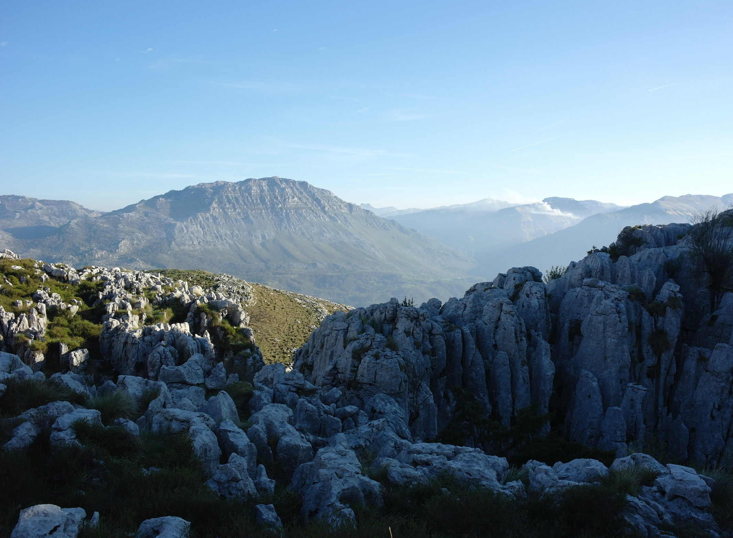
The Matienzo Karst Entomology Project:
Feildwork 2014
Tom Thomson and Fergus McBurney
Speleobiology in the Cantabrian Mountains Northern Spain

Slide 2
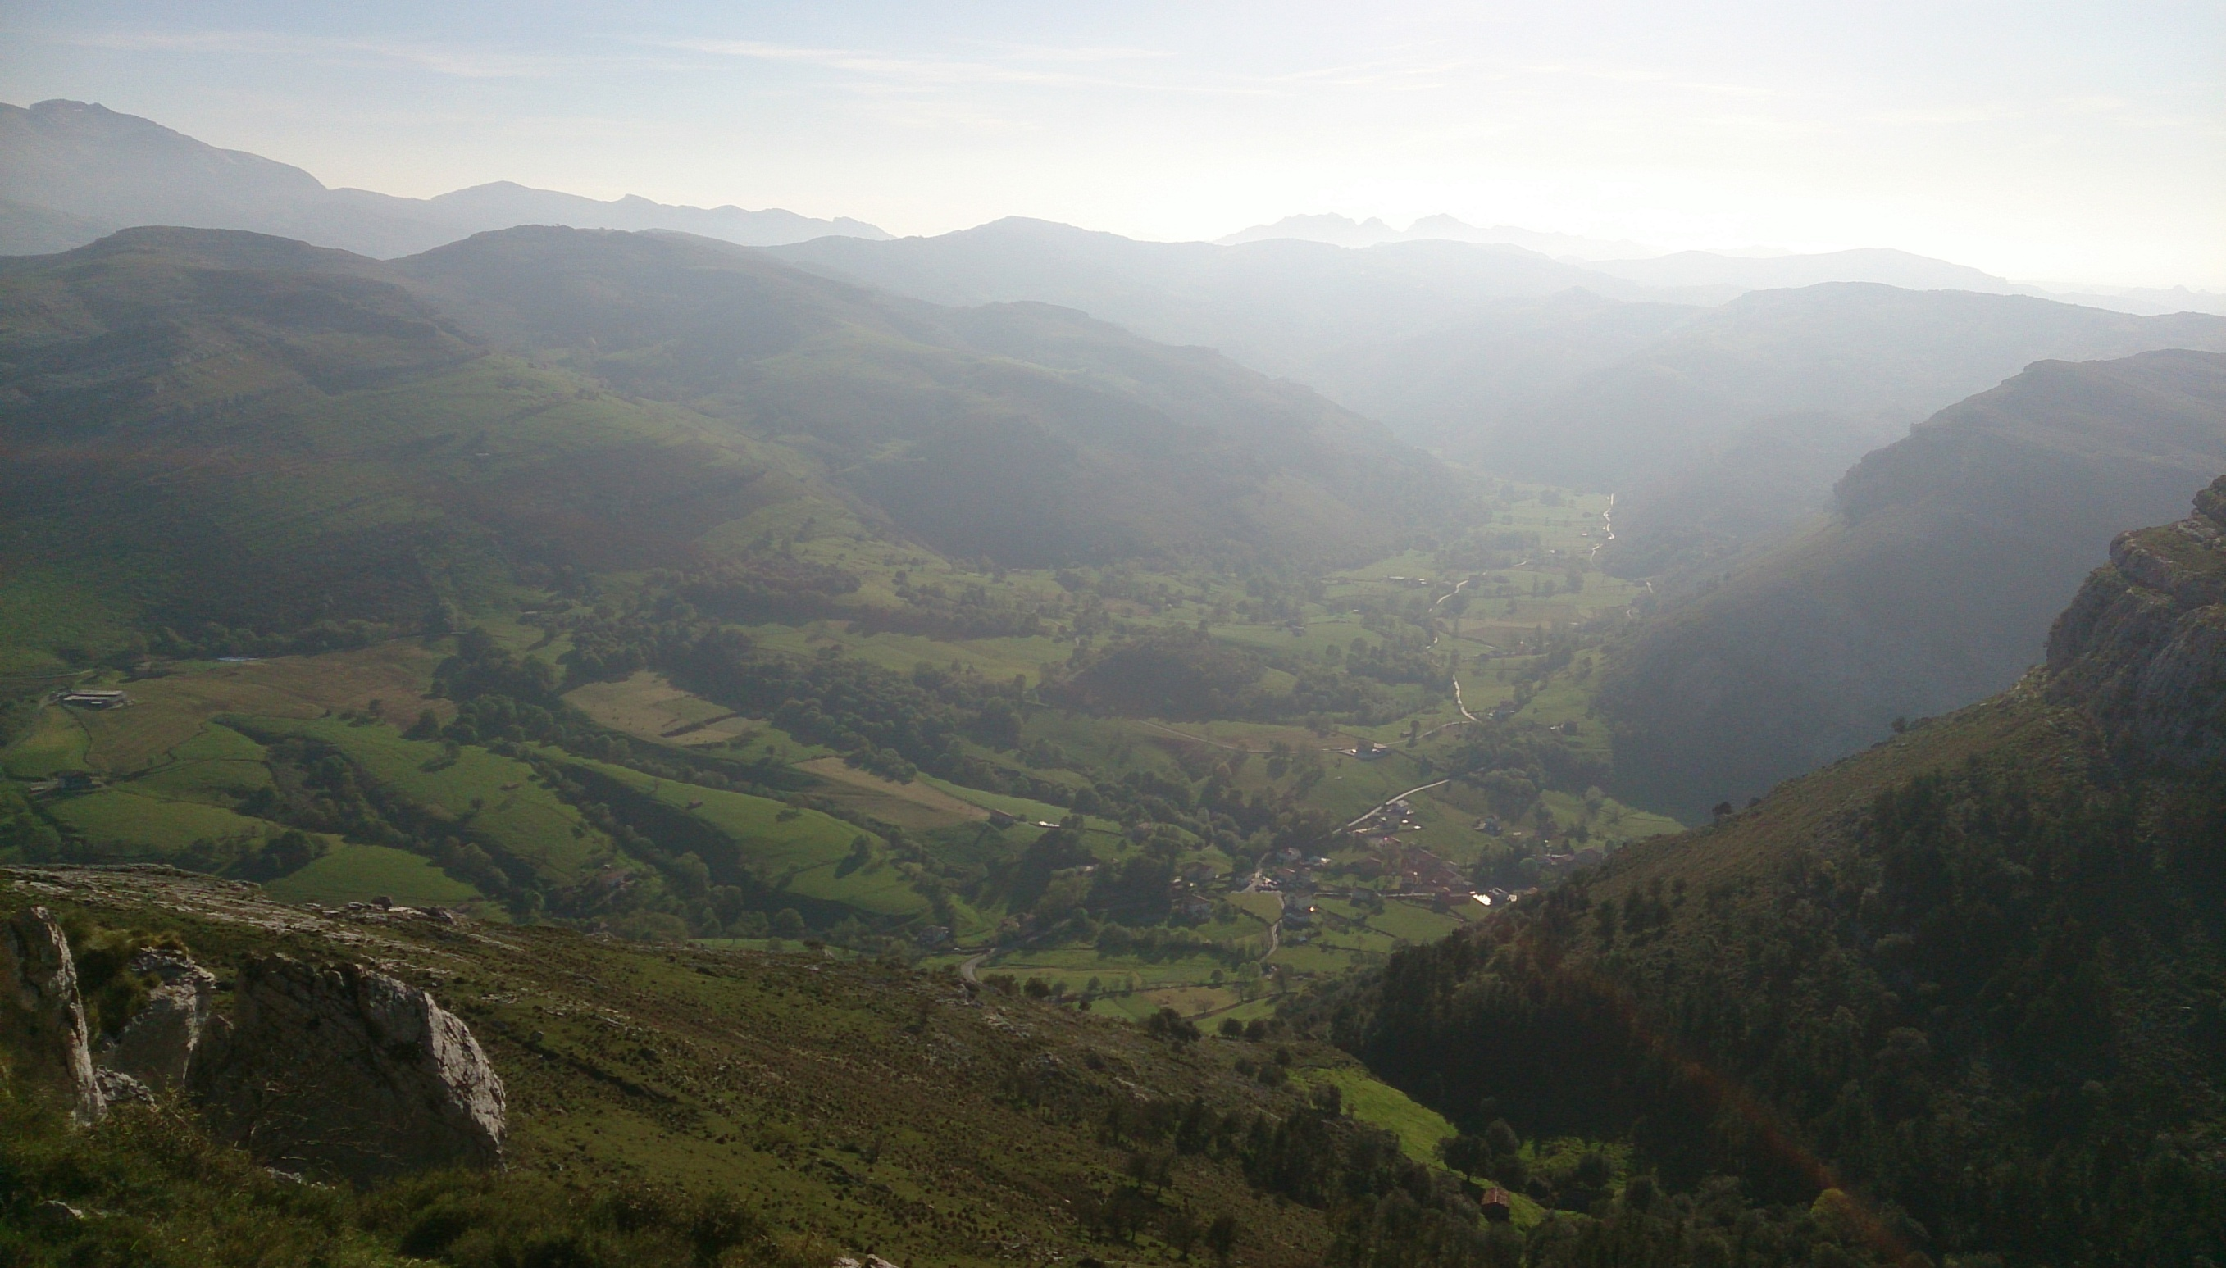
The Matienzo Valley
Image – Tom L Thomson

Slide 3
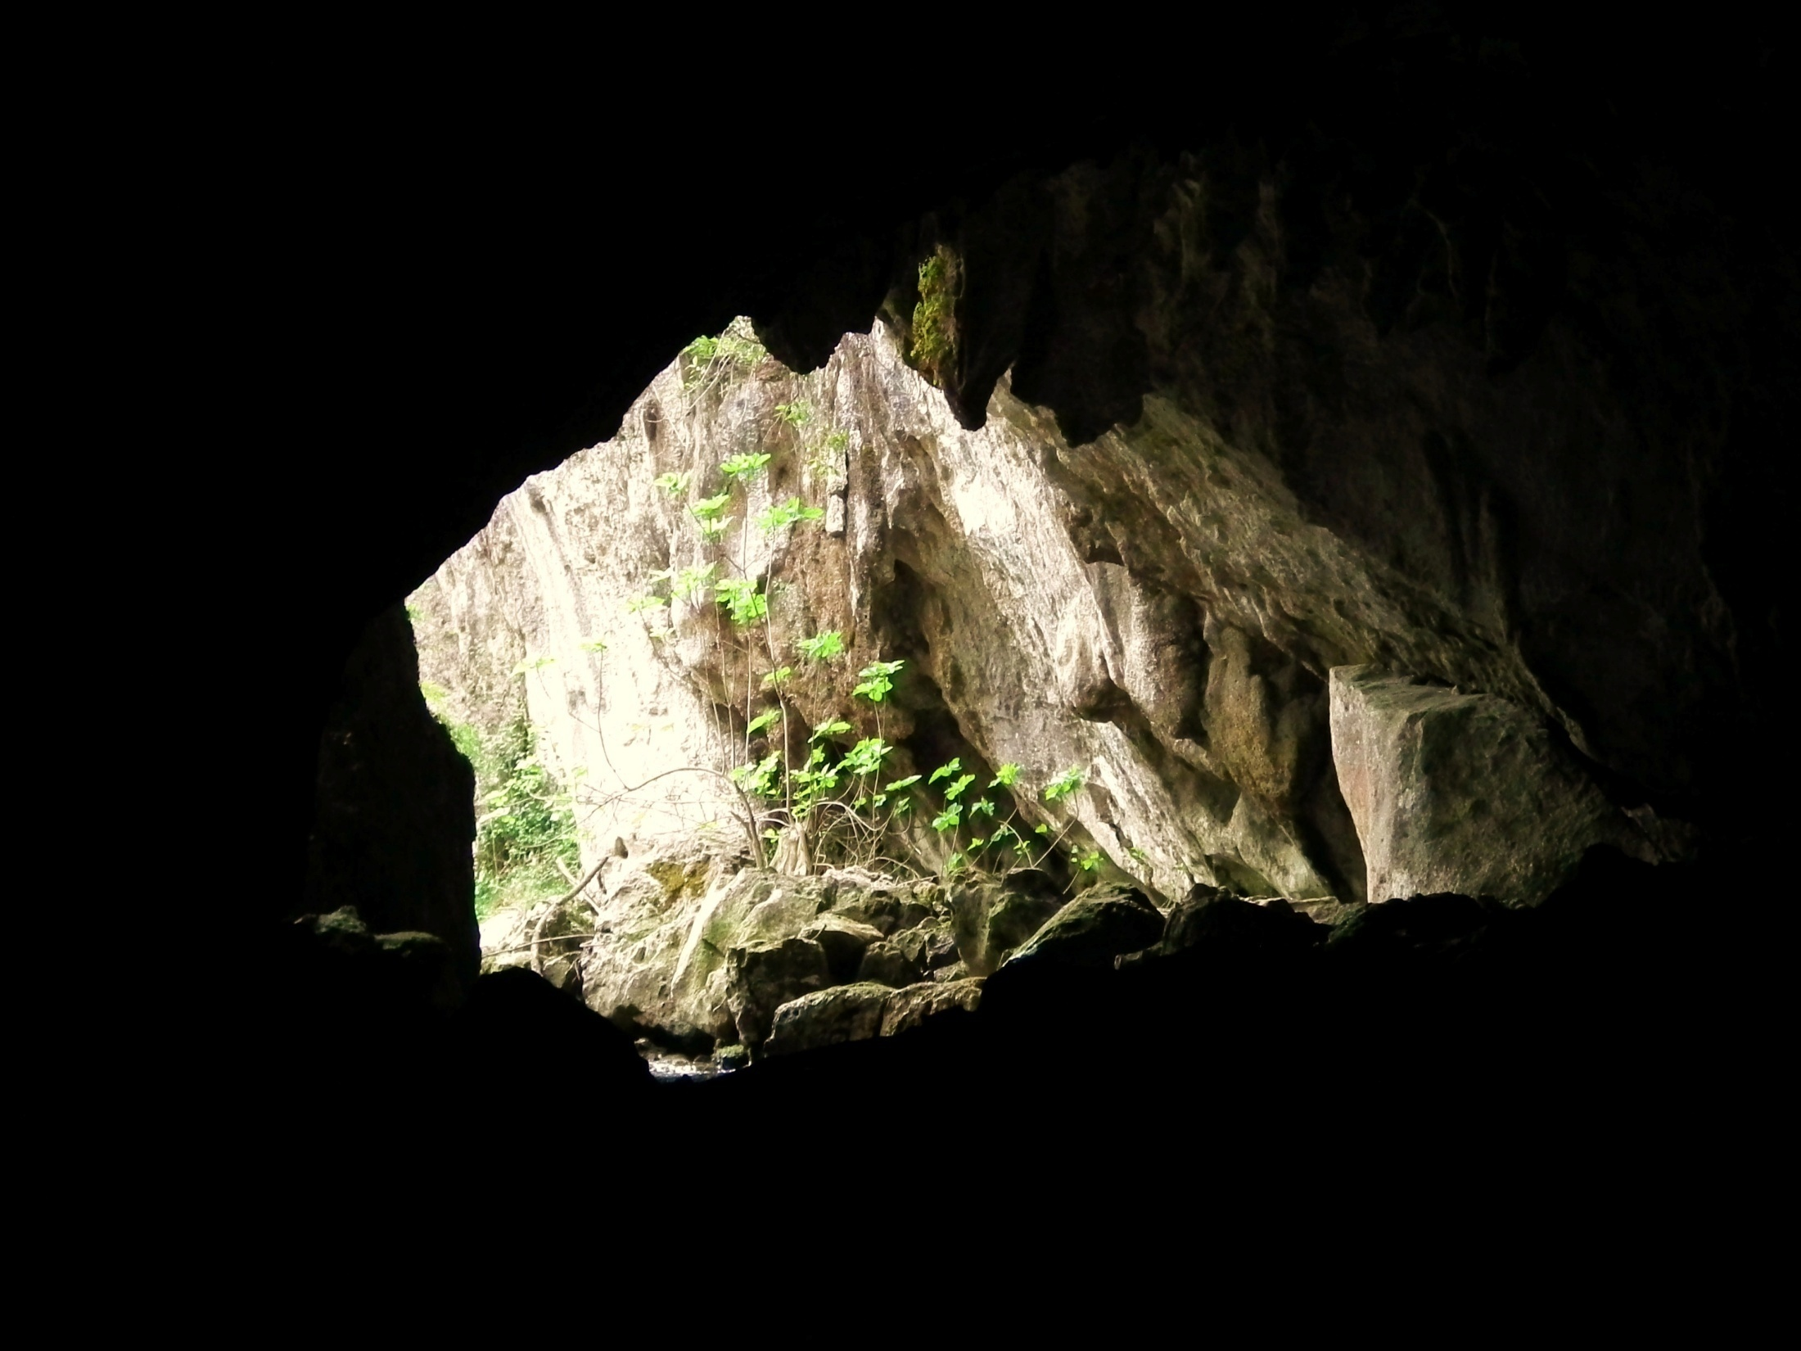
Image – Fergus McBurney

Slide 4
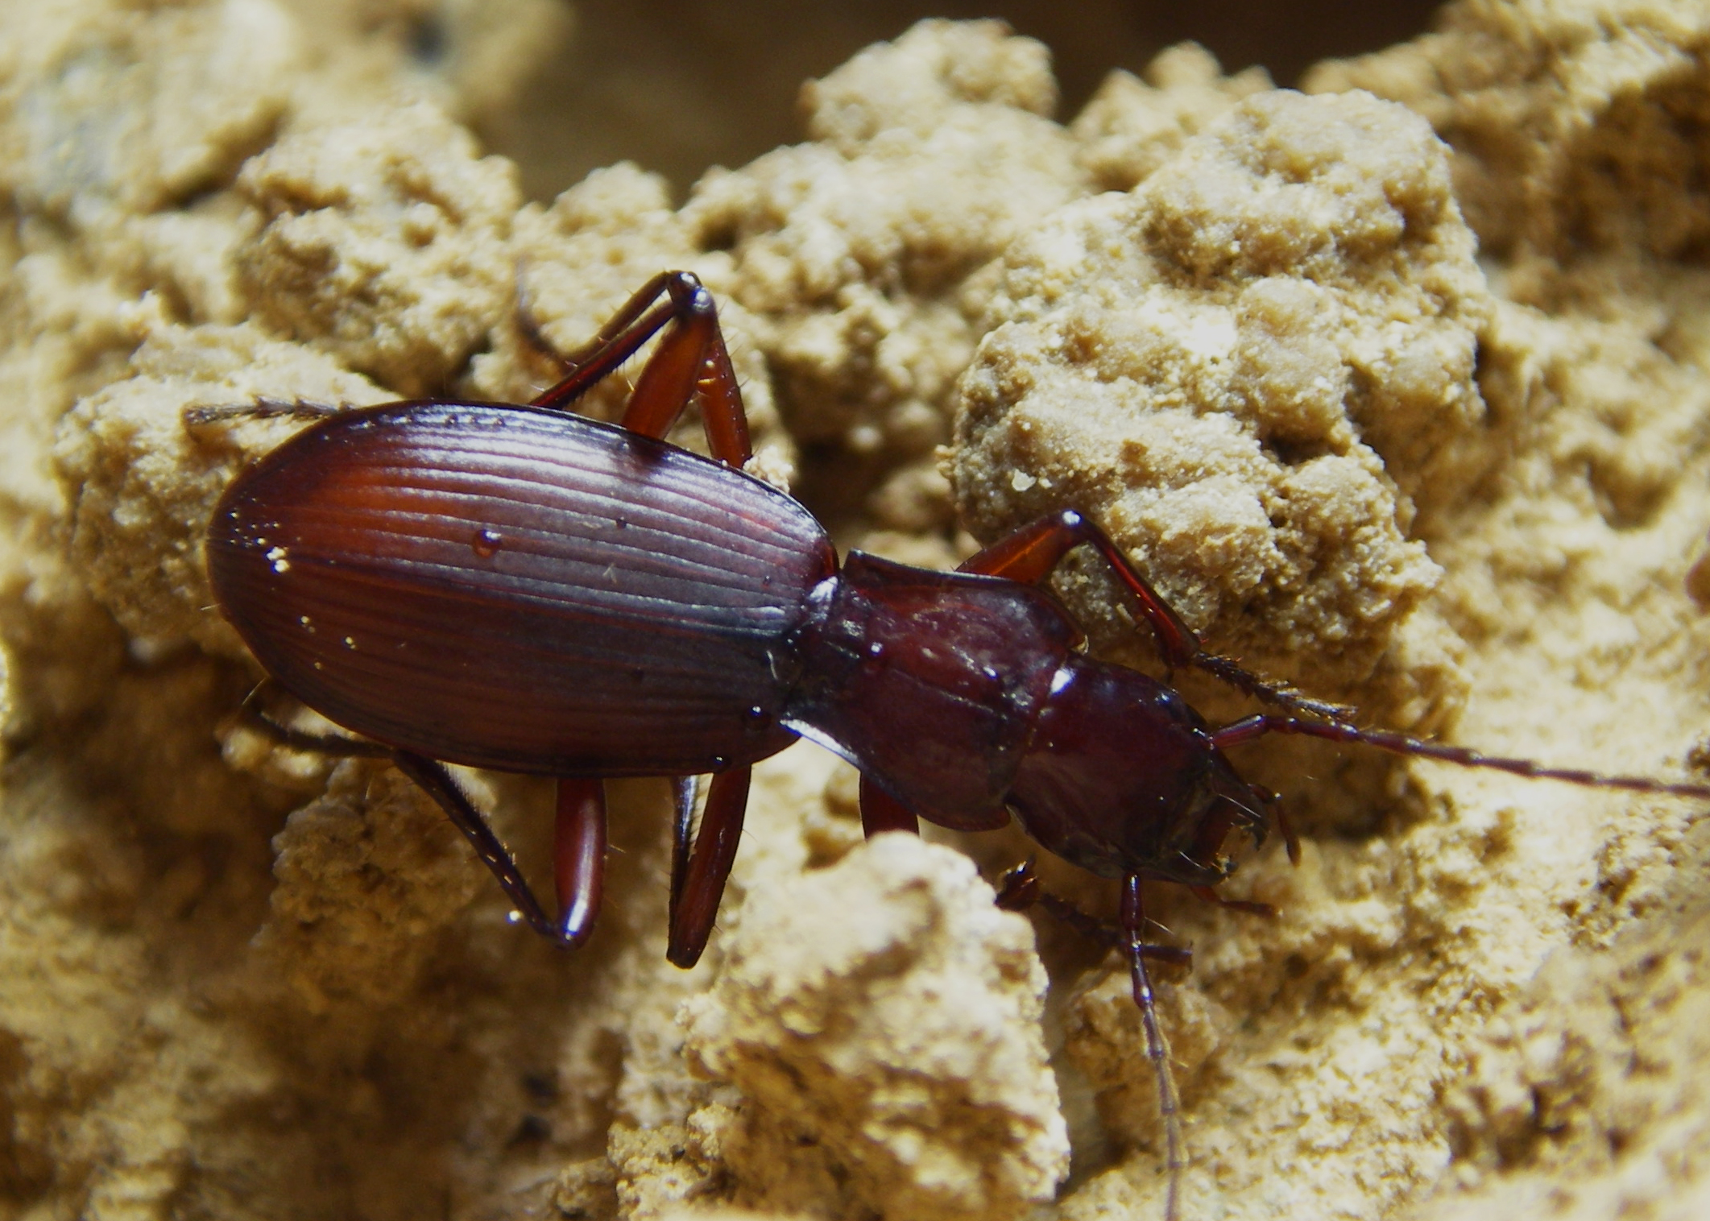
Laemostenus cavicola (Hypogean Ground Bettle) - Torca del Reñada
Image – Tom L Thomson

Slide 5
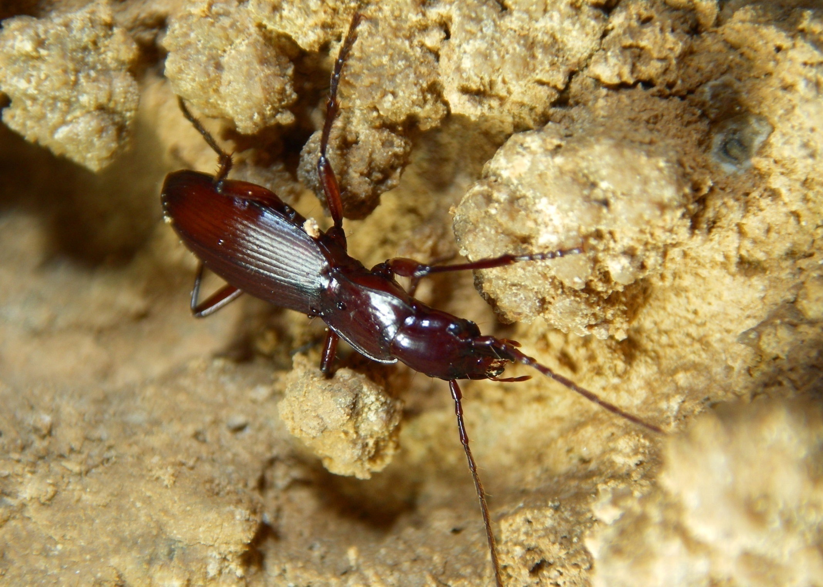
Laemostenus cavicola (Hypogean Ground Bettle) - Torca del Reñada
Image – Tom L Thomson

Slide 6
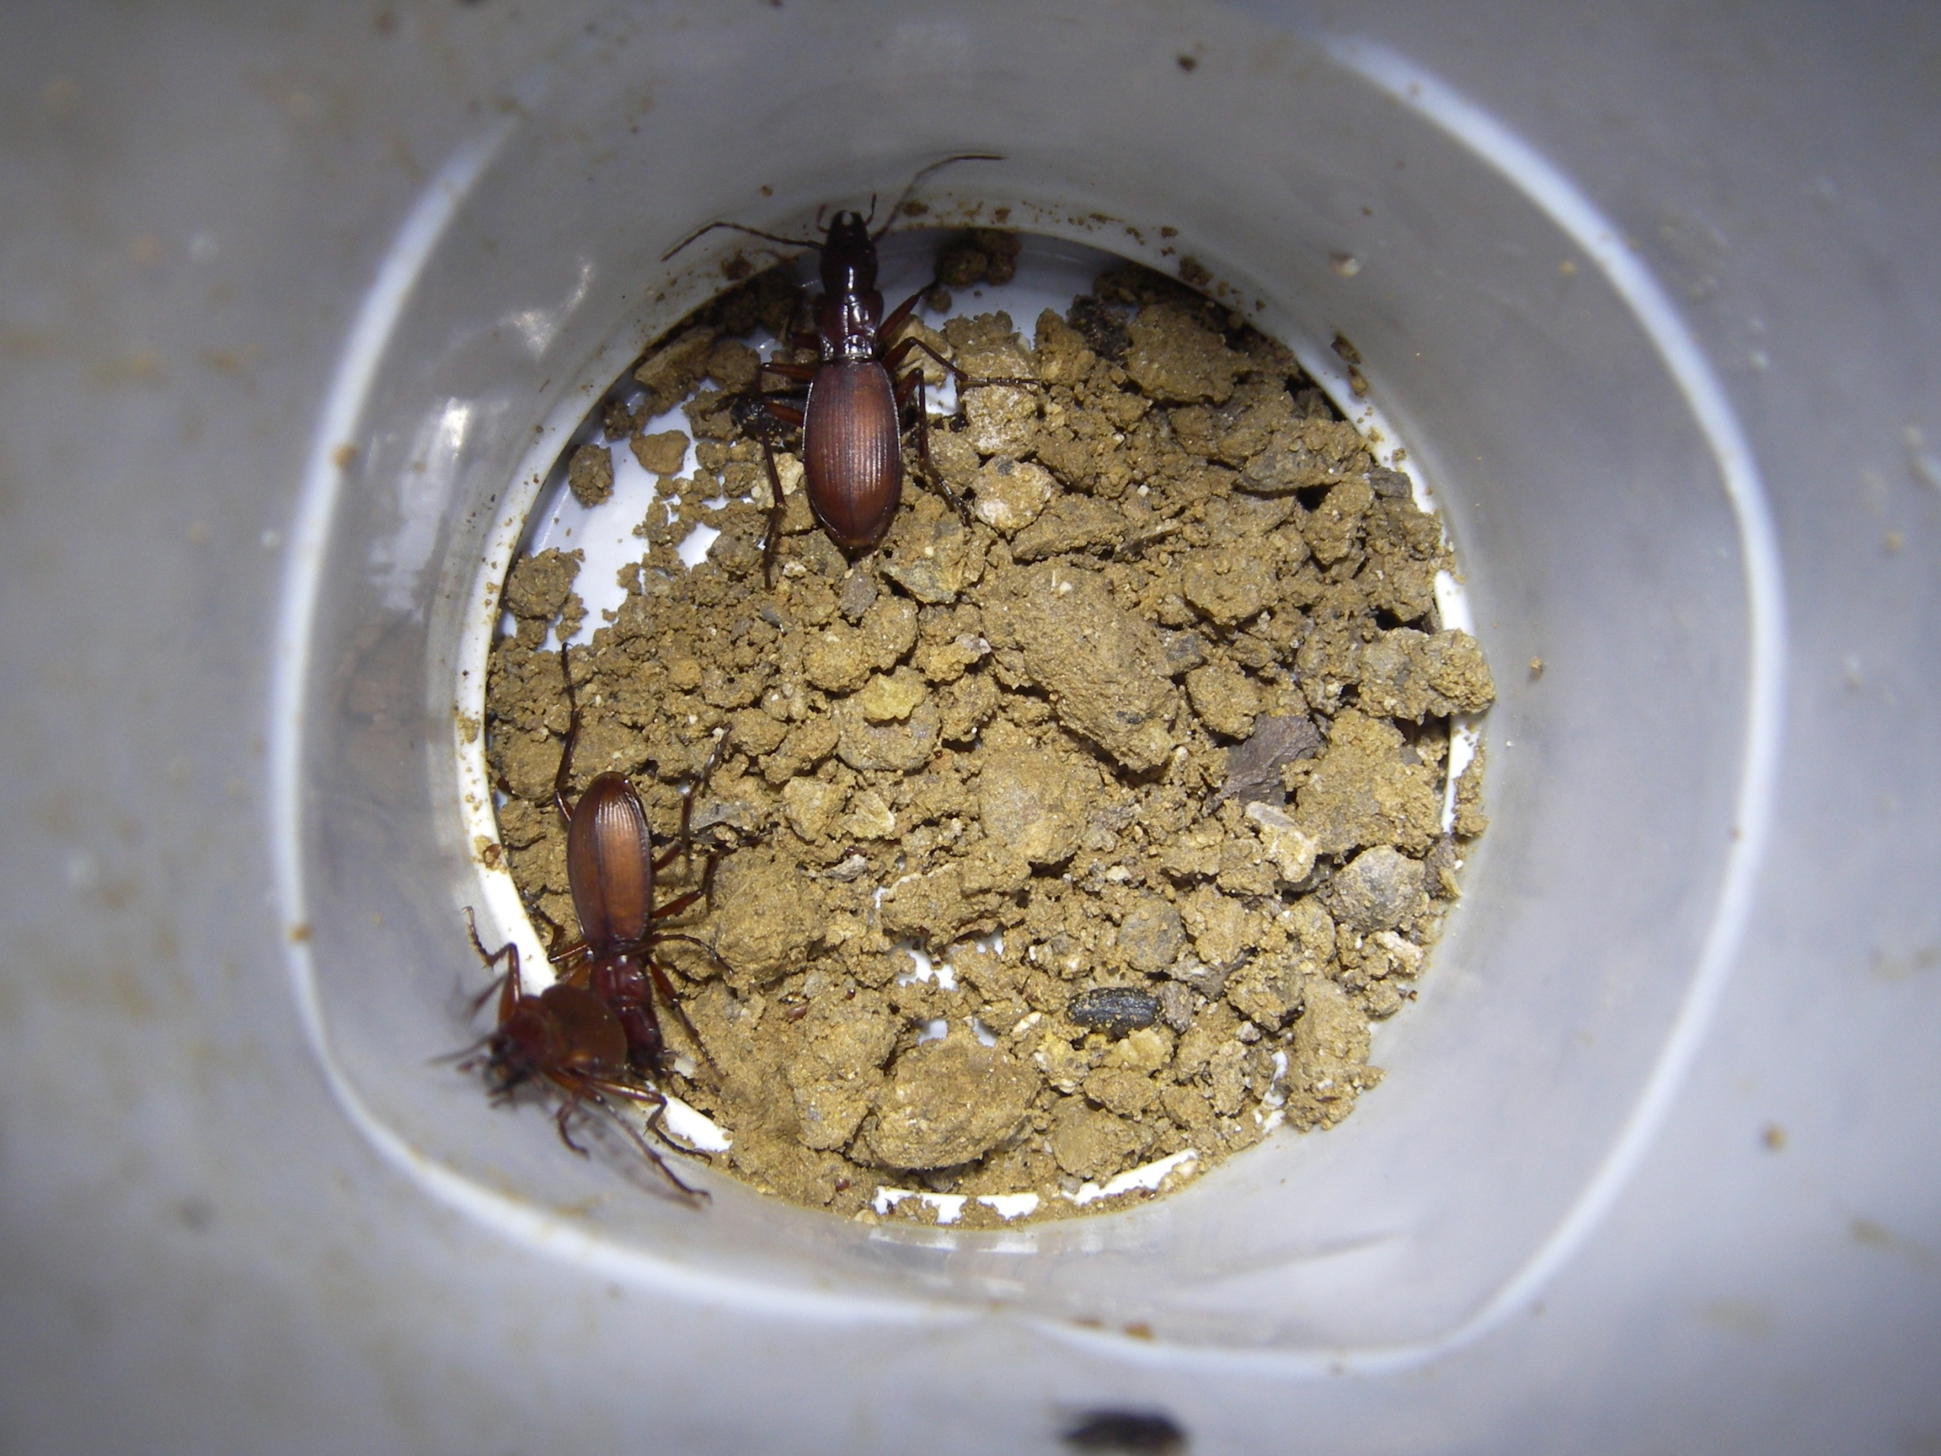
Laemostenus cavicola
Trapping method
Image – Tom L Thomson

Slide 7
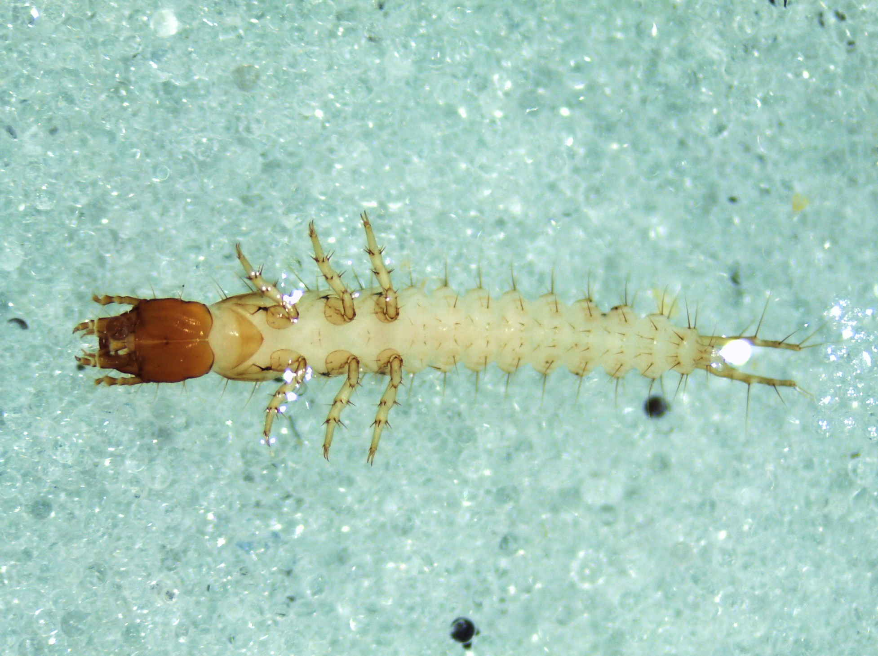
Carabid beetle larva – Laemostenus cavicola??
Image – Tom L Thomson

Slide 8
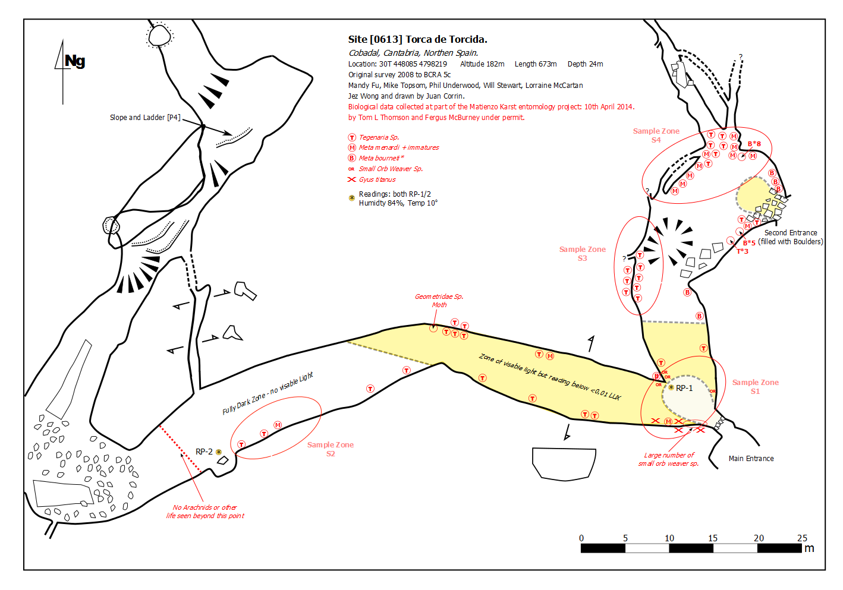
Species distribution recording:

Slide 9
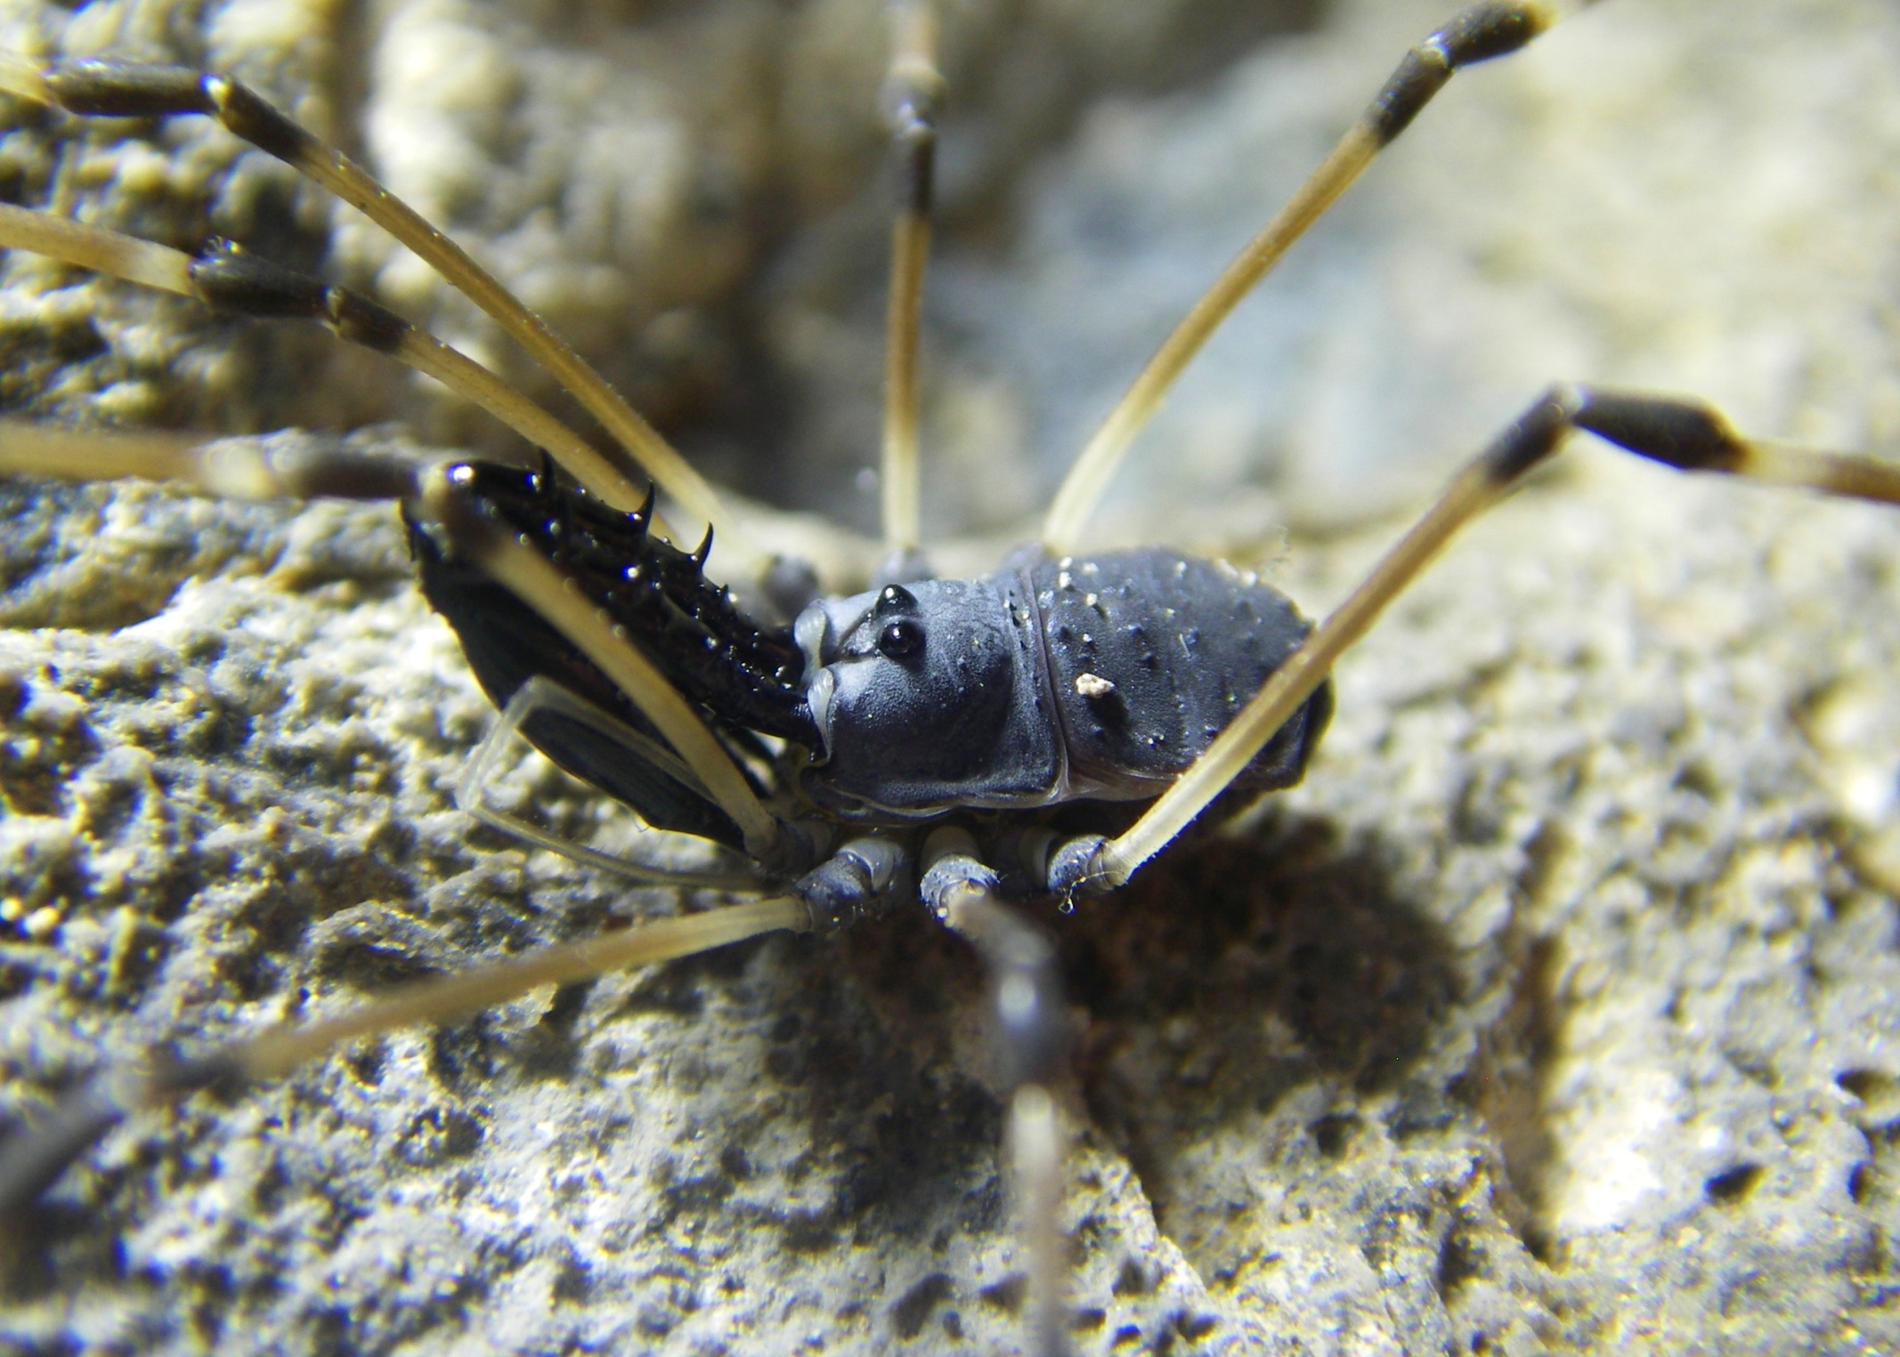
Ischyropsalis hispanica – Cueva de Jivero 2.
Image – Tom L Thomson
Notes:
Leiobunum blackwalli

Slide 10
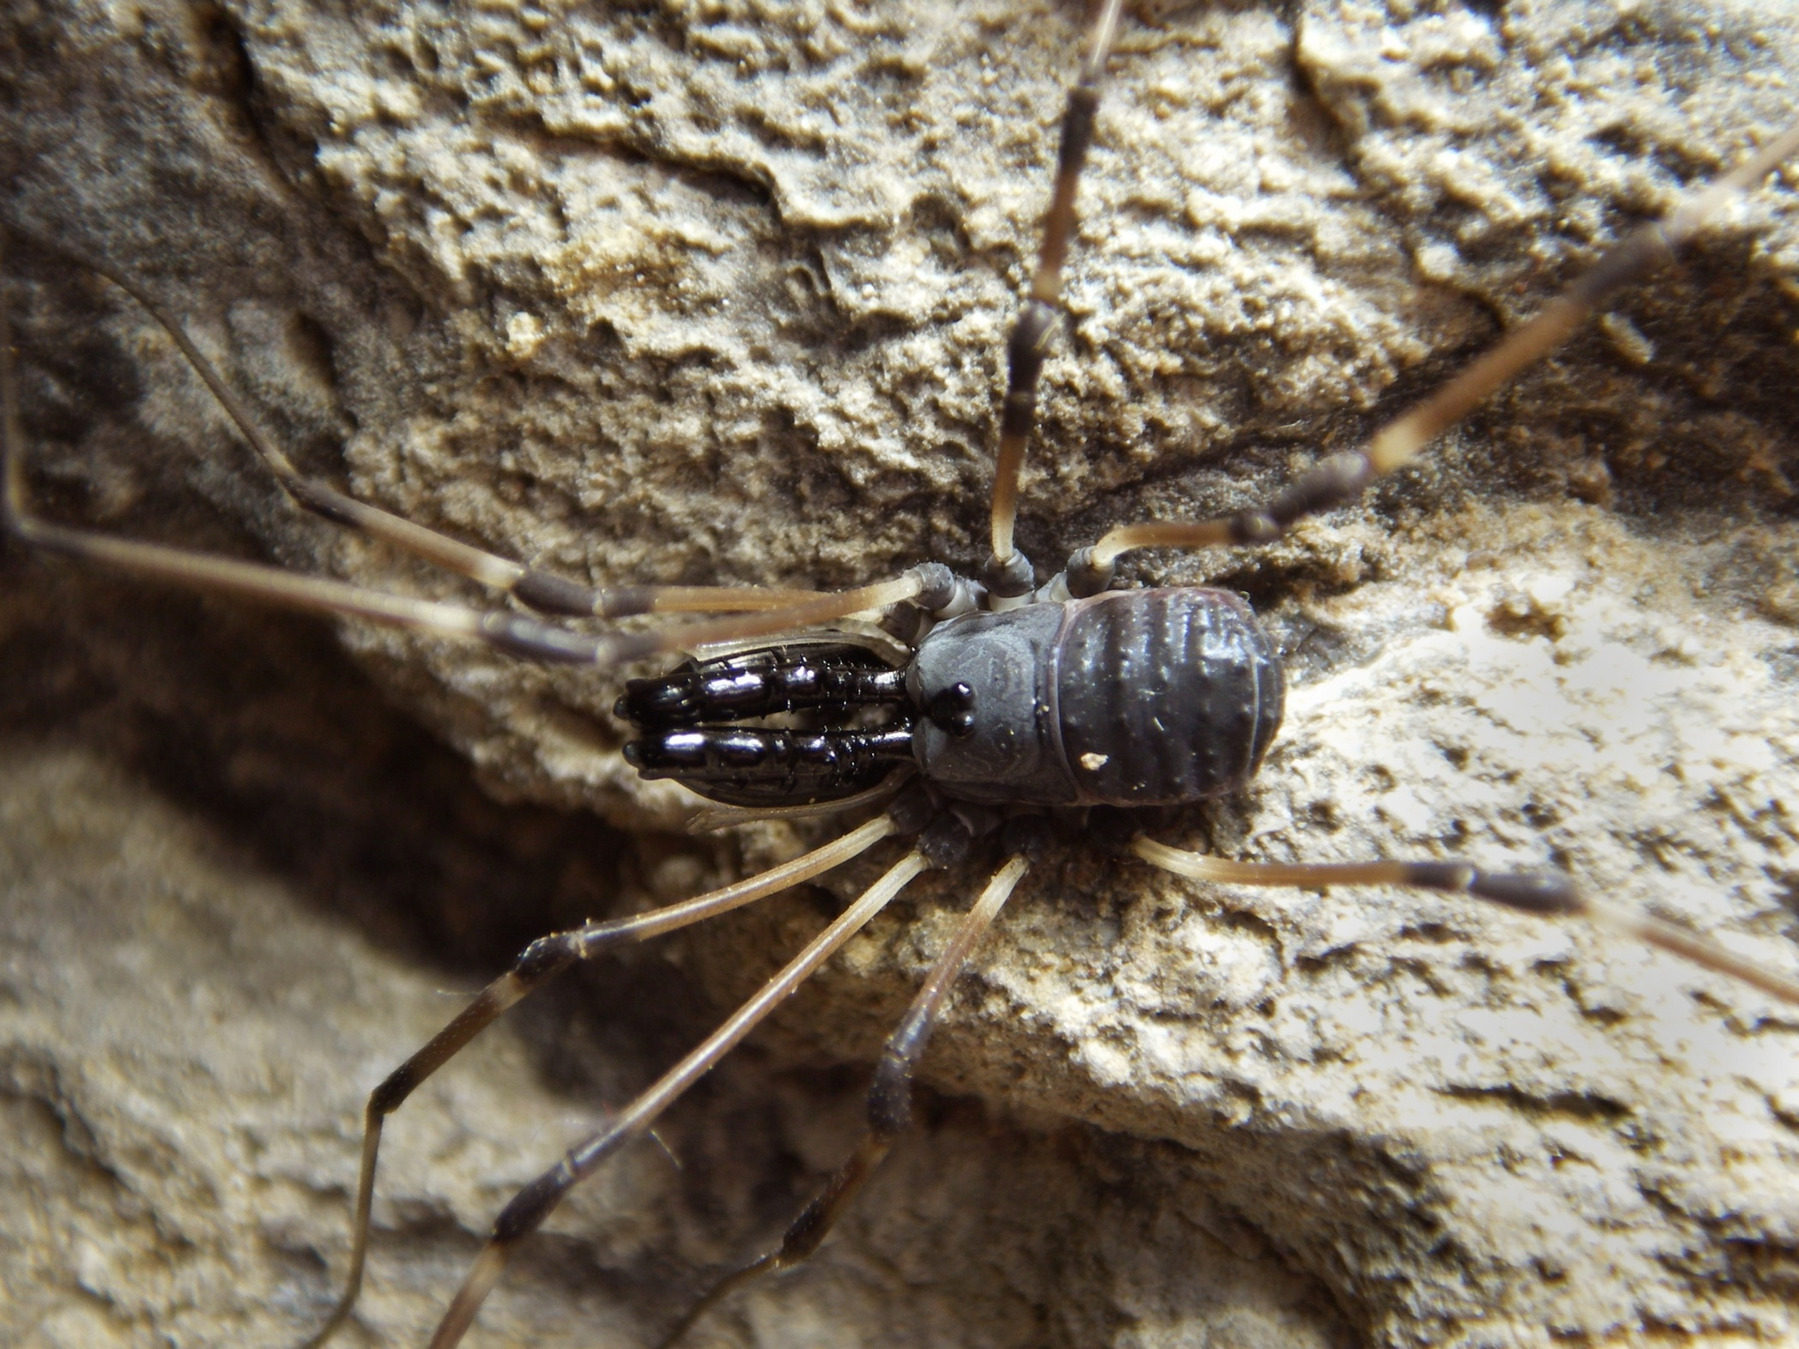
Ischyropsalis hispanica – Cueva de Jivero 2.
Image – Tom L Thomson

Slide 11
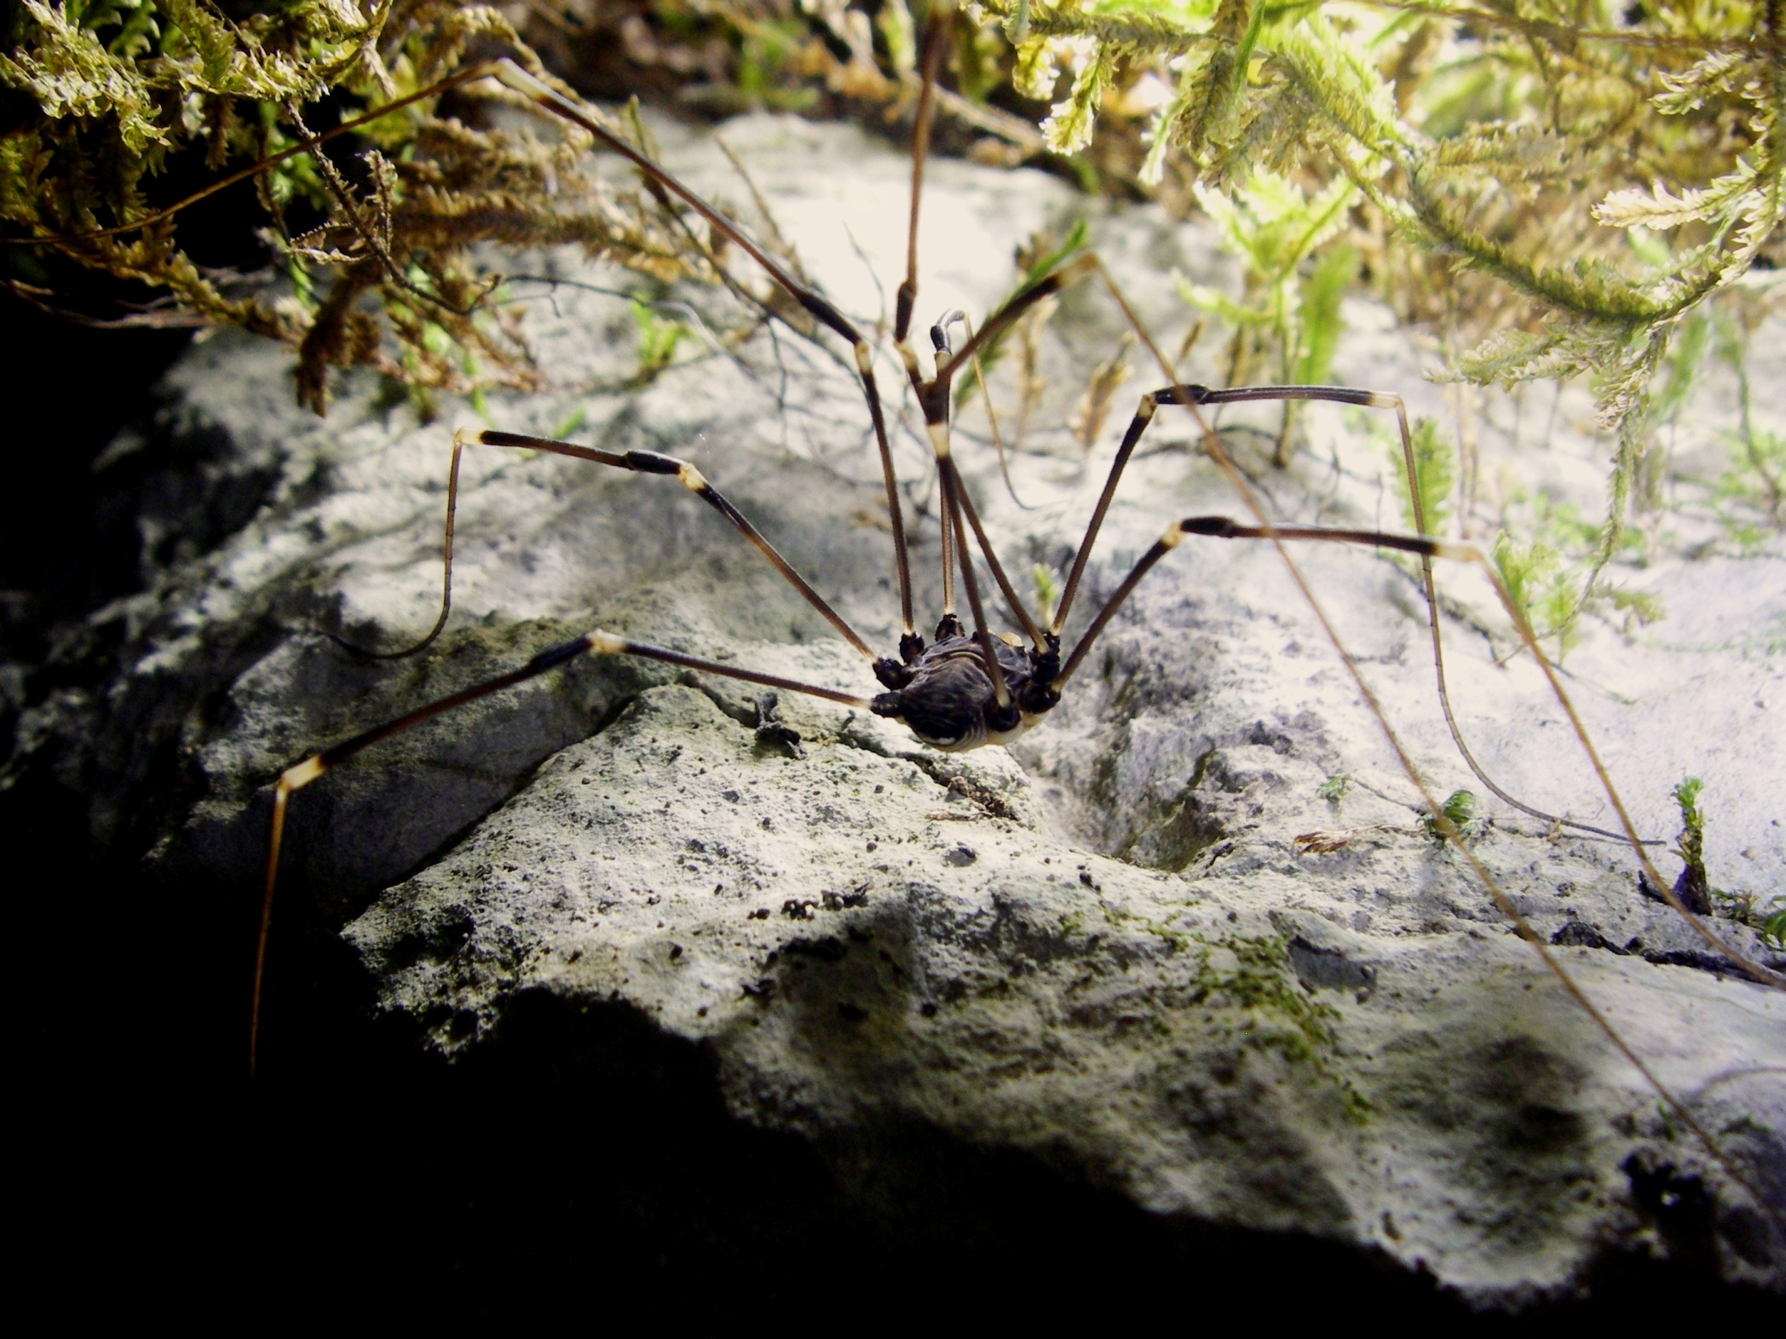
Gyas titanus – La Bodega.
Image – Tom L Thomson

Slide 12
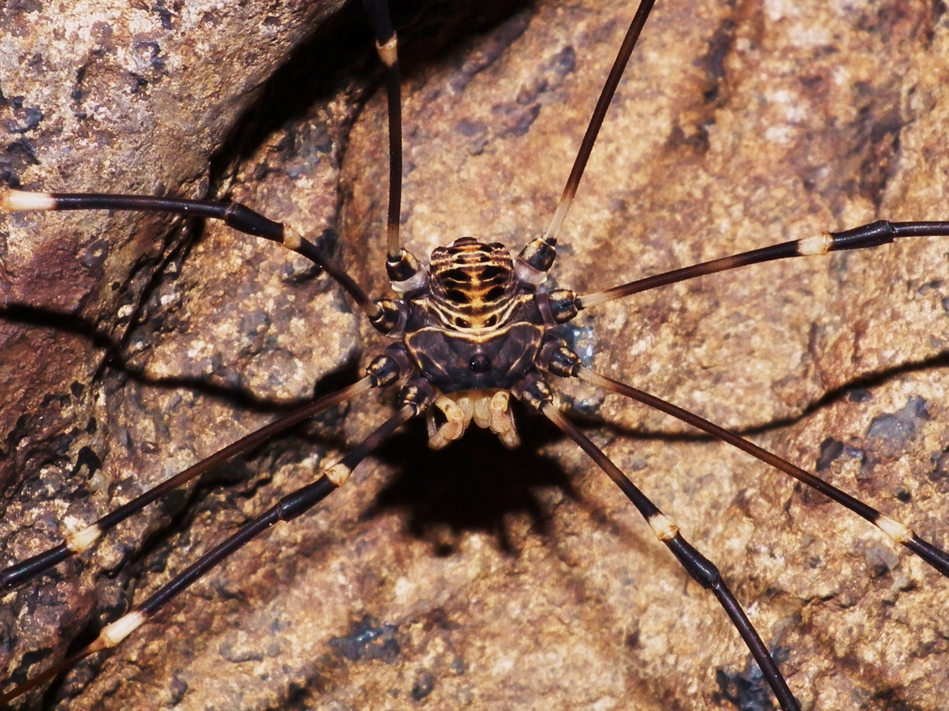
Gyas titanus – Cueva del Agua
Image – Fergus McBurney

Slide 13
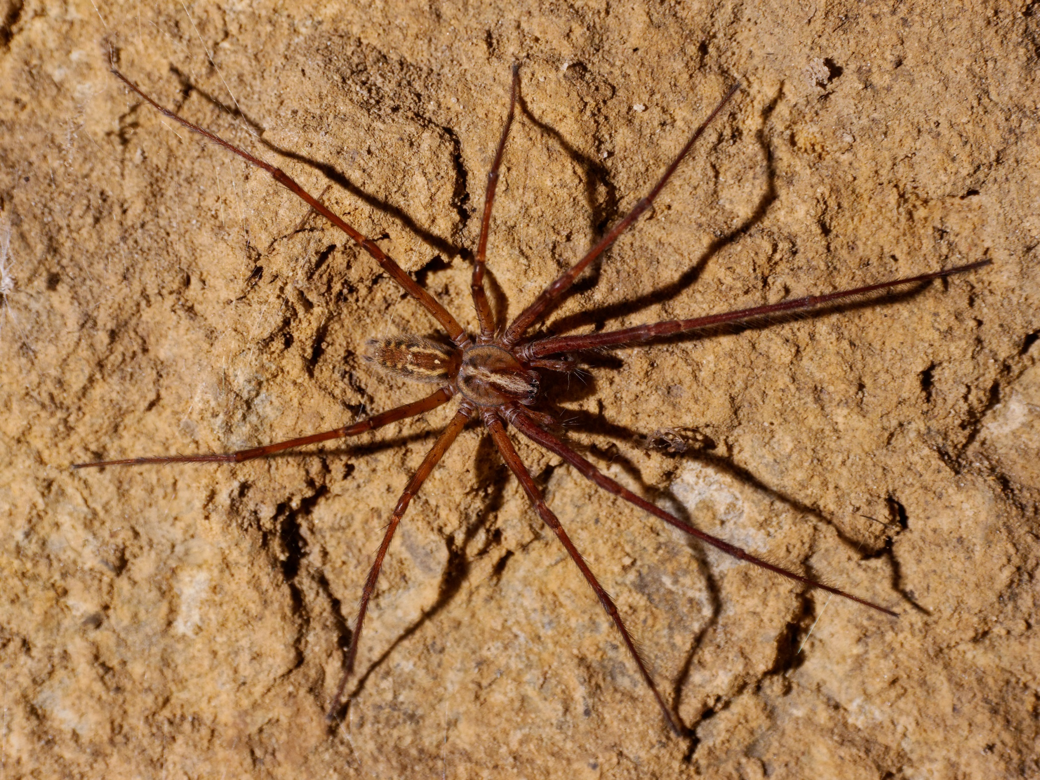
Tegenaria Sp. – Letterbox Cave.
Image - Paul Fretwell

Slide 14
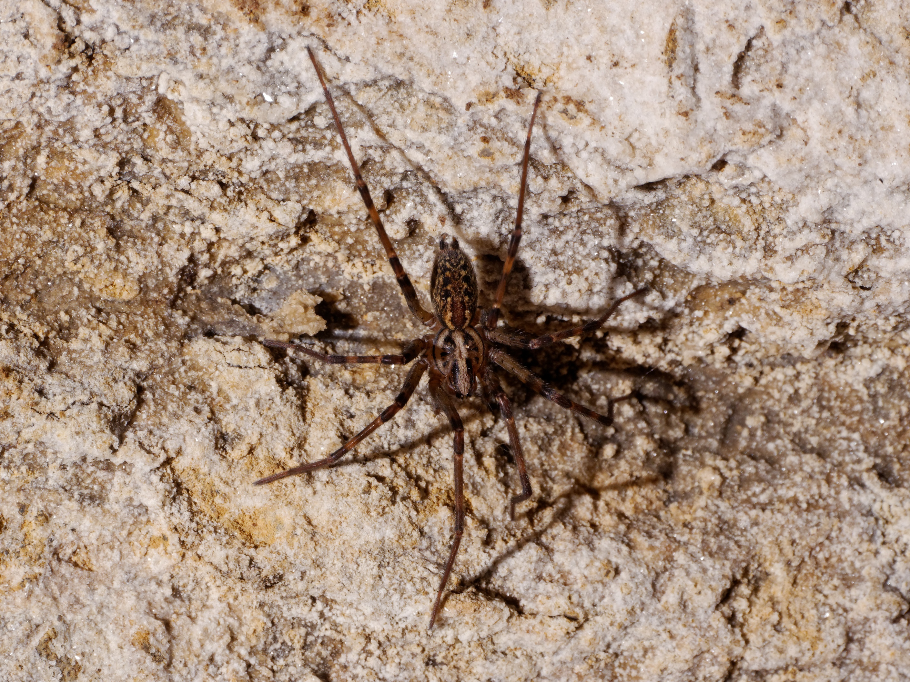
Tegenaria Sp. – Letterbox Cave.
Image - Paul Fretwell

Slide 15
Meta Menardi – Letterbox Cave.
Image - Paul Fretwell

Slide 16
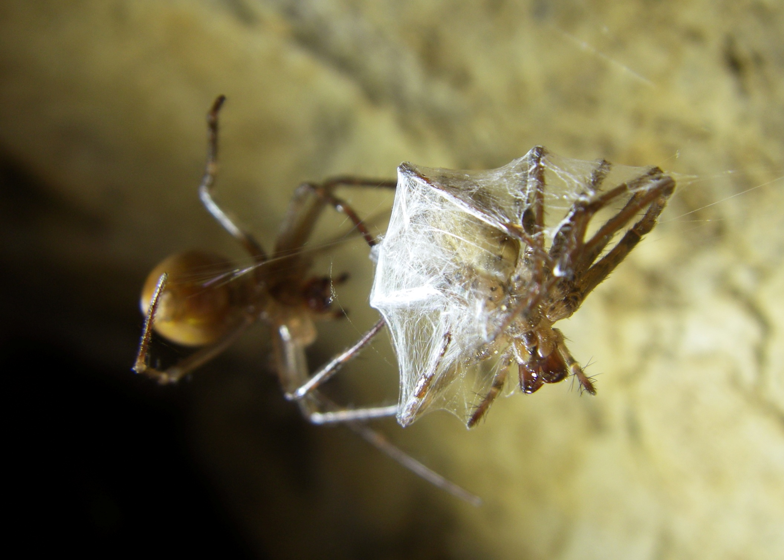
Meta Menardi and Tegenaria Sp. – Letterbox Cave.
Image – Tom L Thomson

Slide 17
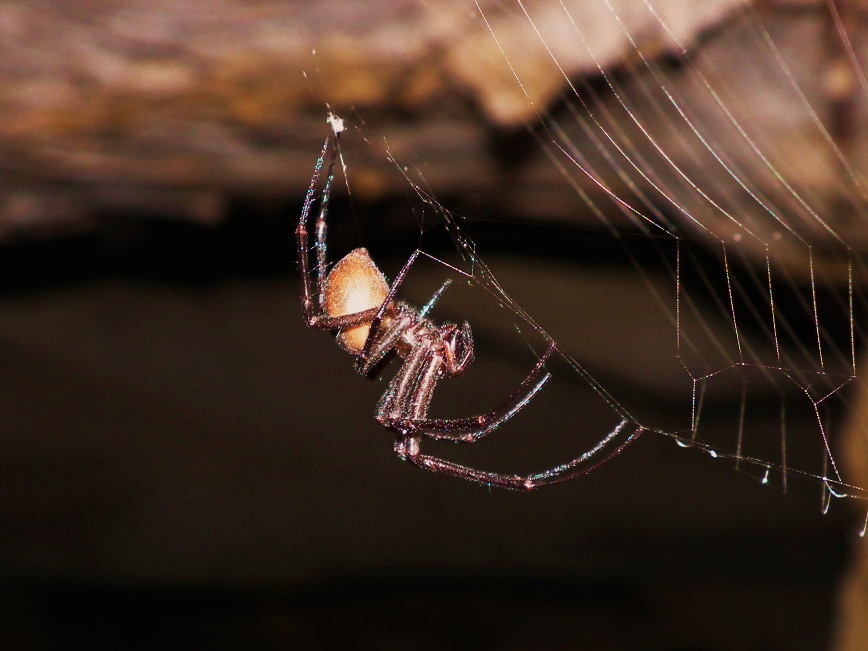
ida
Meta bourneti – Cueva de Torcida
Image – Fergus McBurney
Image – Fergus McBurney

Slide 18
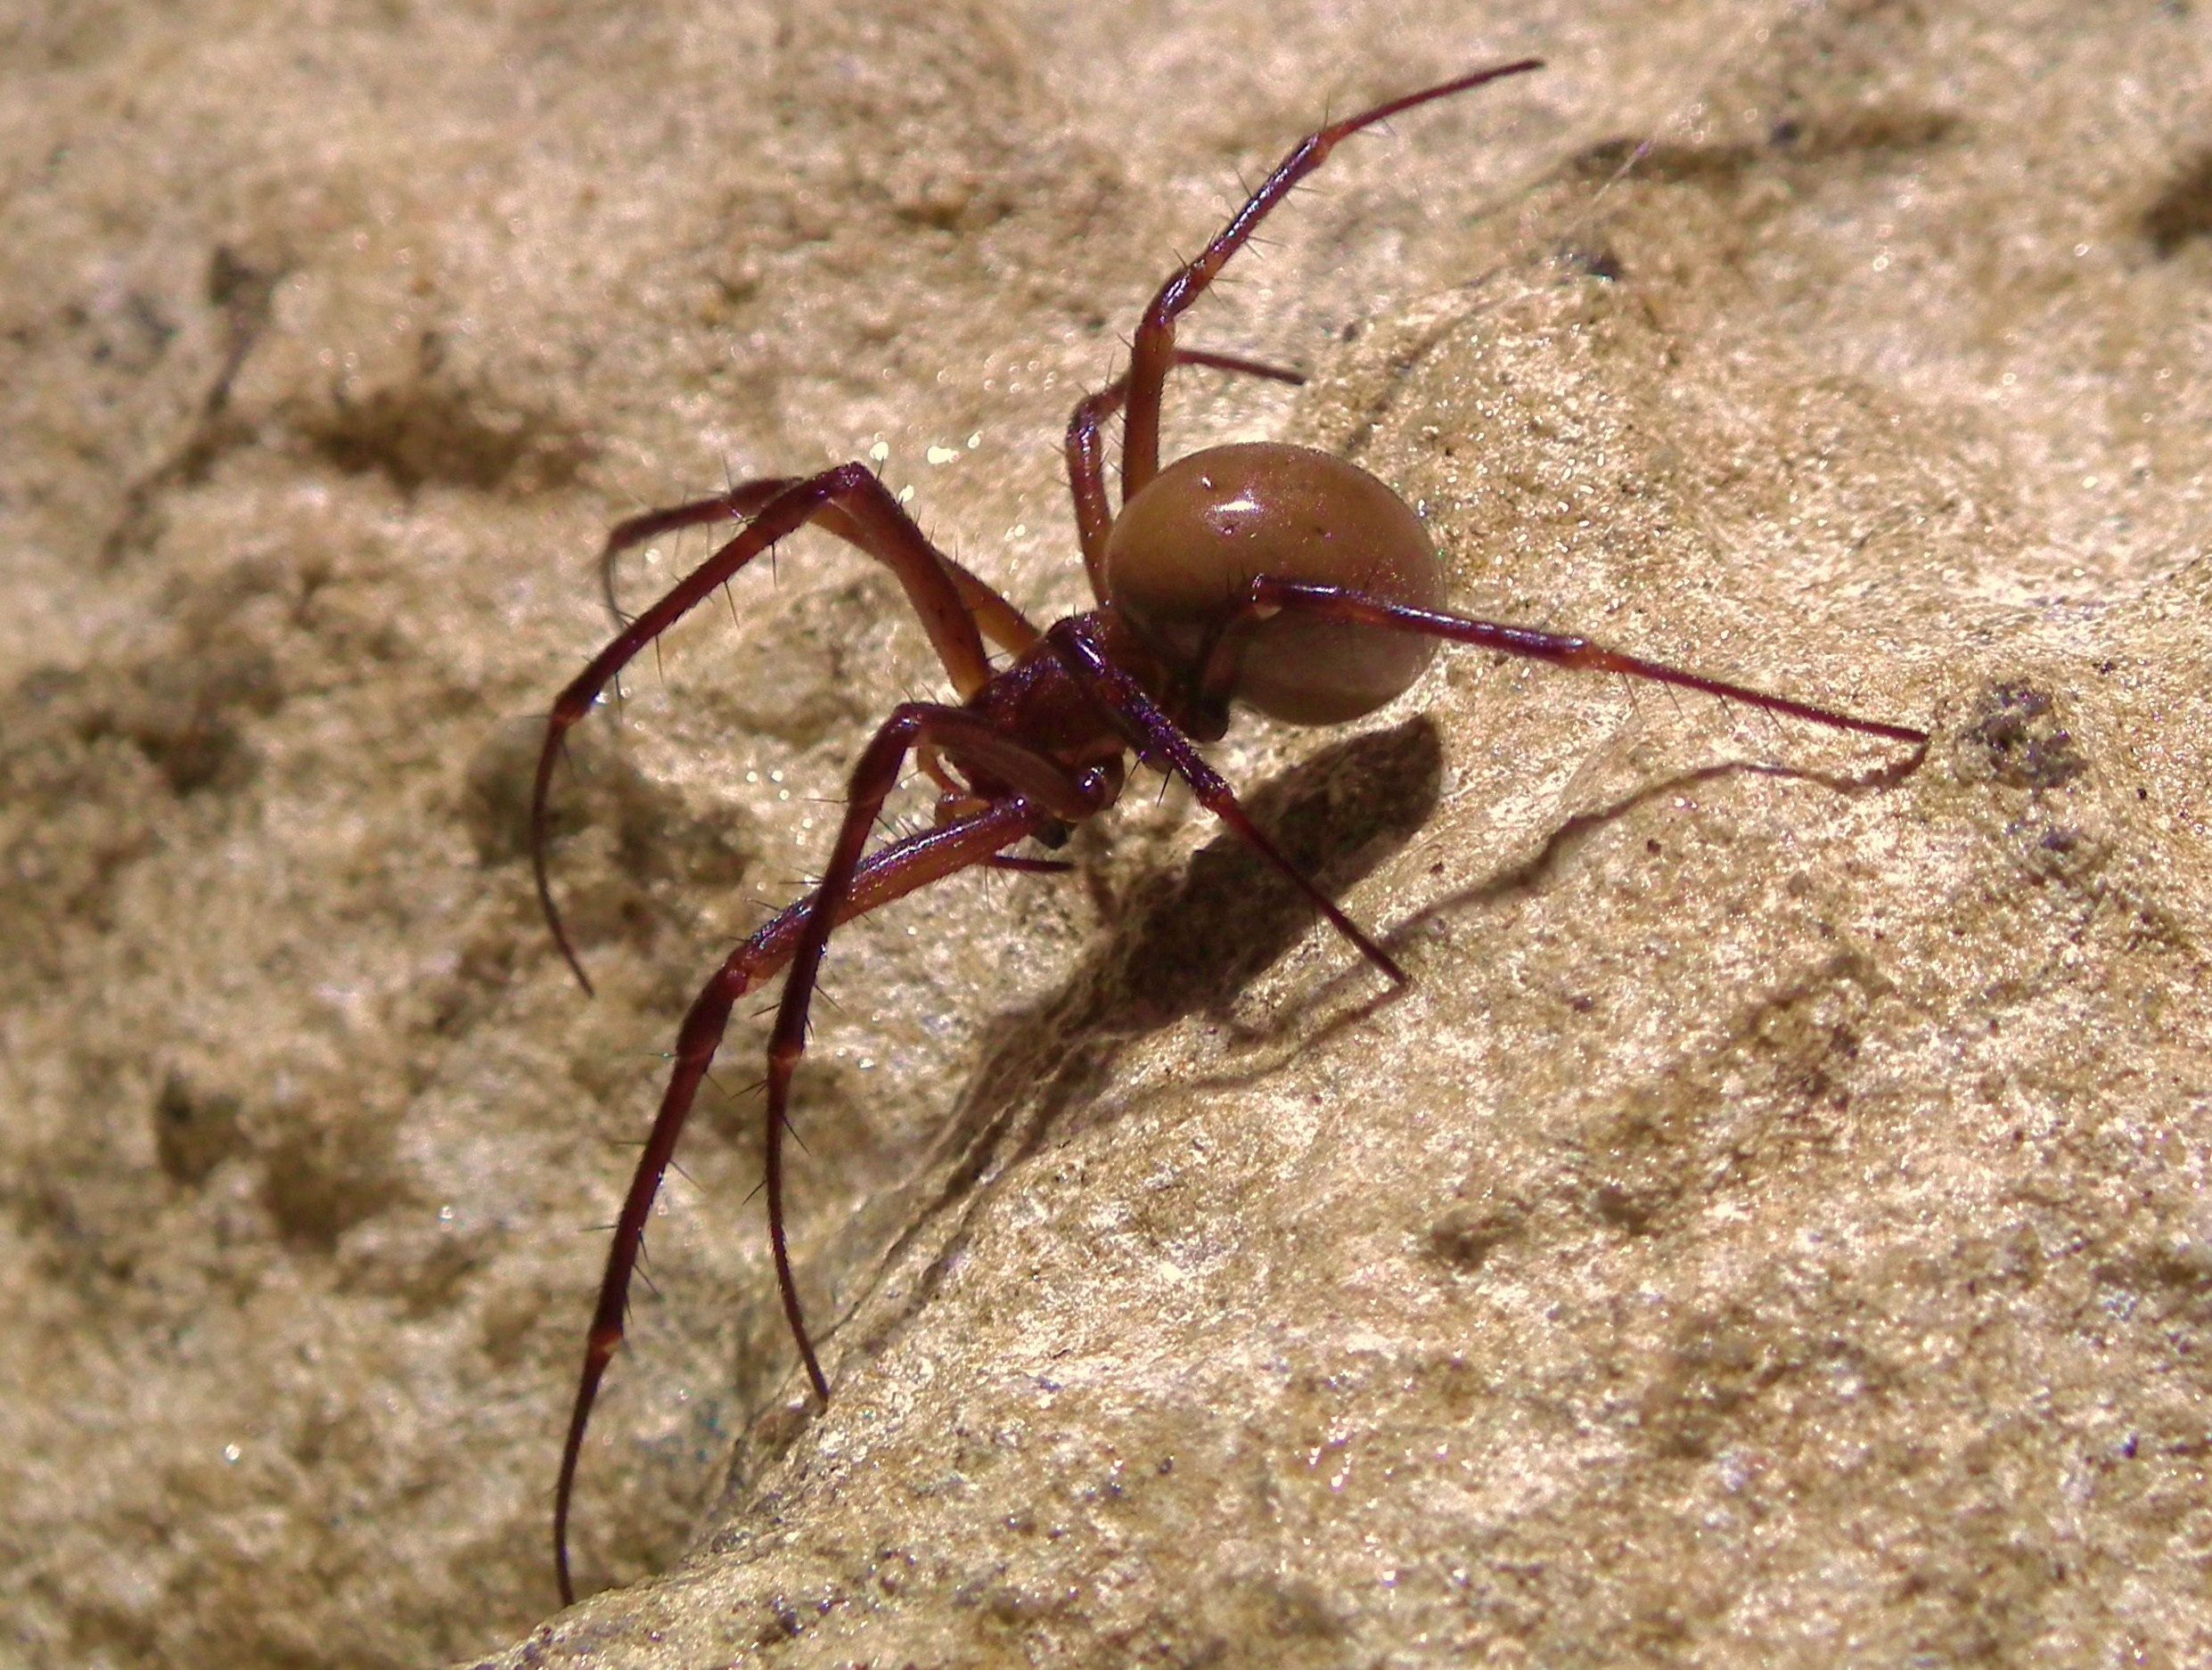
Meta bourneti – Cueva del Agua
Image – Fergus McBurney

Slide 19
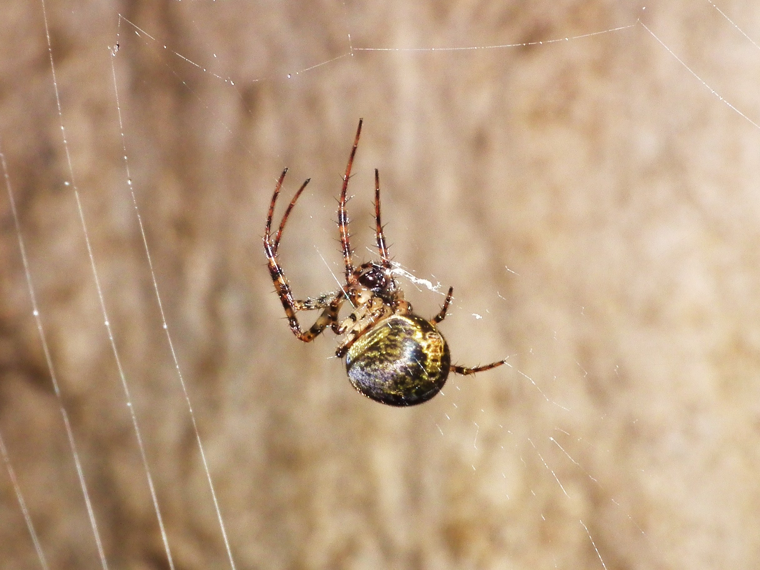
Metellina merianae – Cueva del Agua
Image – Fergus McBurney

Slide 20
Linyphiid Sp? - Cueva del Risco.
Image - Paul Fretwell
Notes:
Iberina mazarredoi

Slide 21
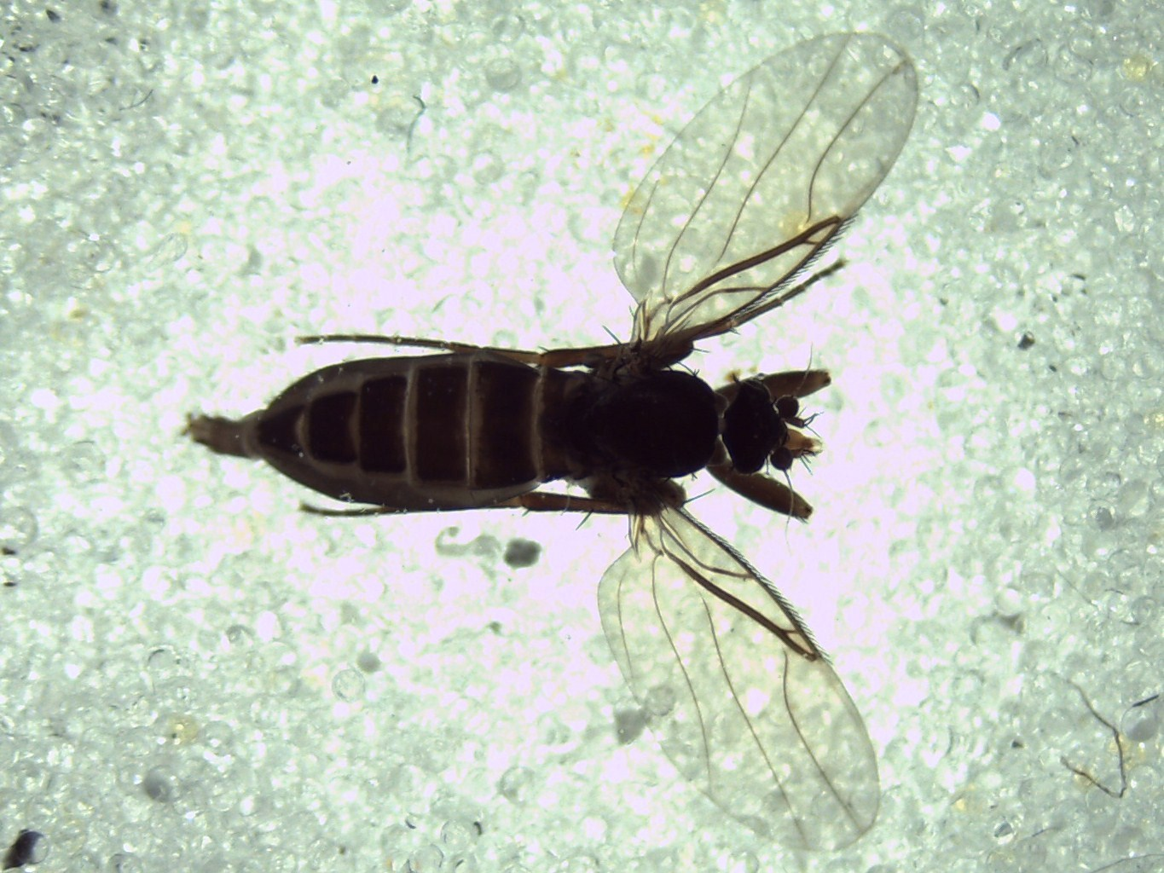
Phoridae (Scuttle Flies)
Image – Fergus McBurney

Slide 22
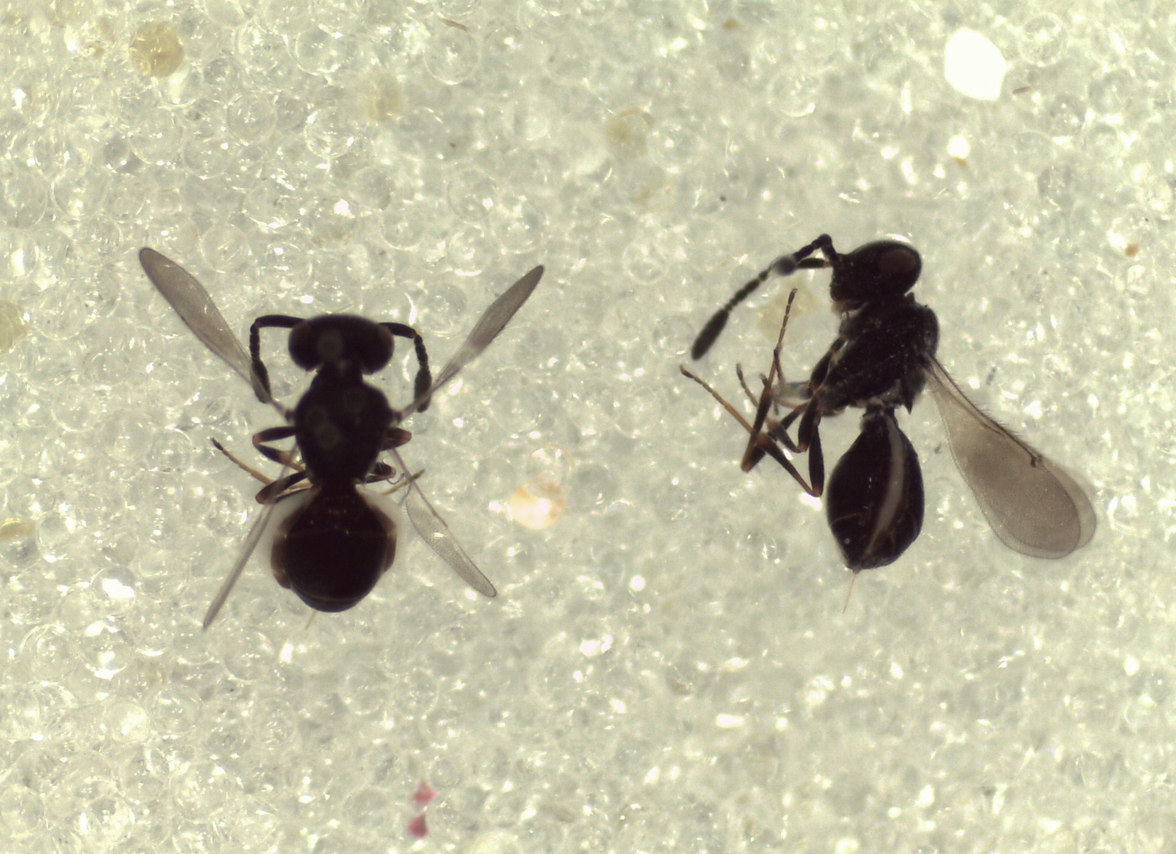
Chalcidoidea (Parasitic Wasp)
Image – Fergus McBurney

Slide 23
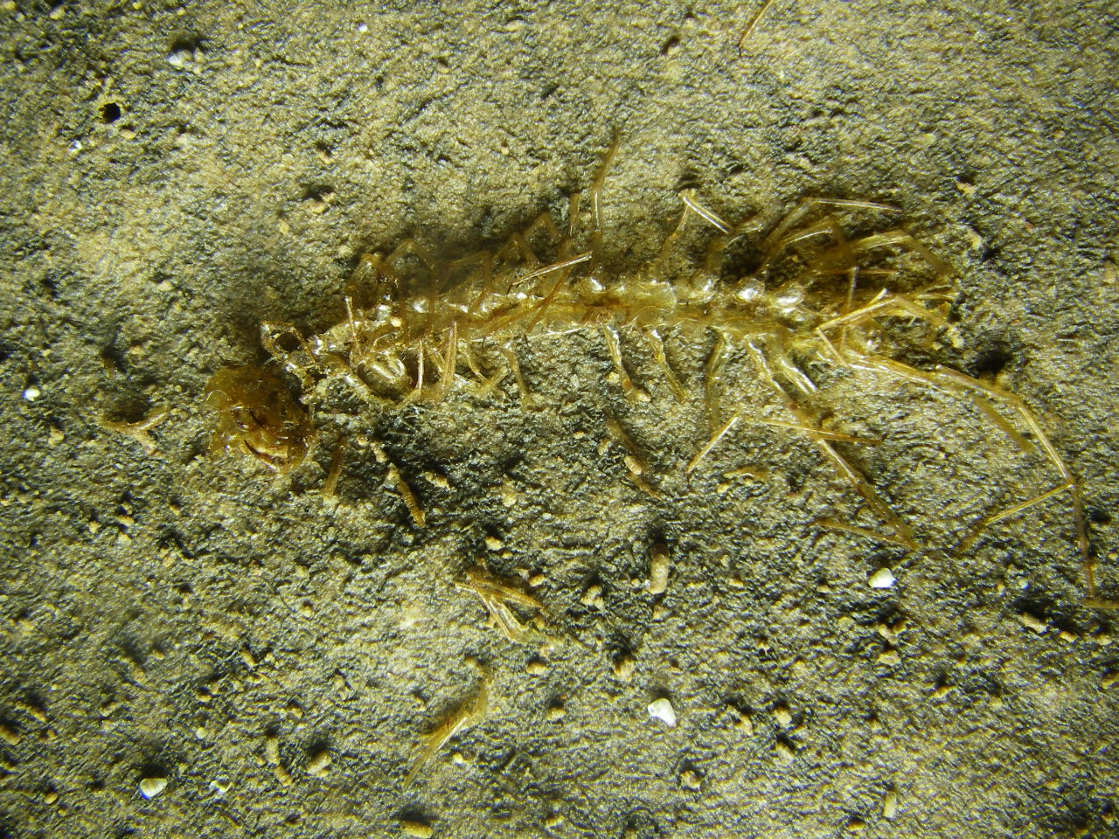
Shed skin of Lithobius Sp. Centipede - Cueva de Riaño.
Image – Tom L Thomson

Slide 24
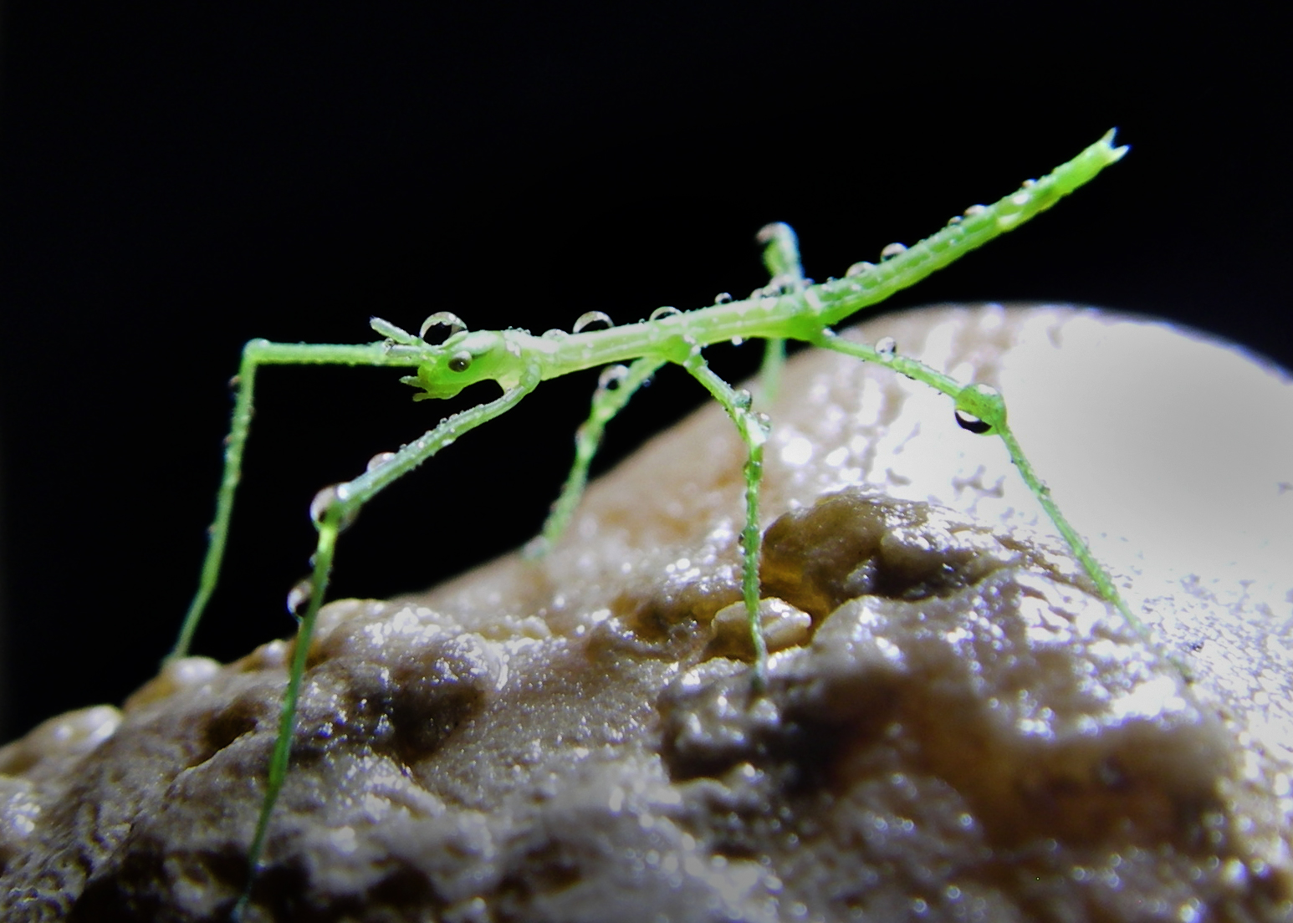
Phasmatodea Sp. (immature stick insect) - Cueva-Cubío de la Reñada.
Image – Tom L Thomson

Slide 25
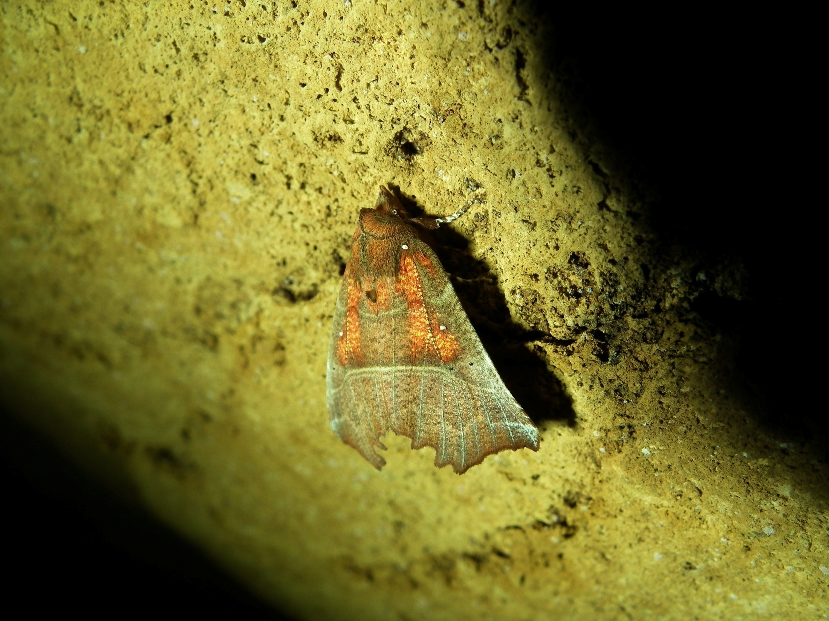
Scoliopterix libatrix (Herald moth) – Cueva de Torcida
Image – Fergus McBurney

Slide 26
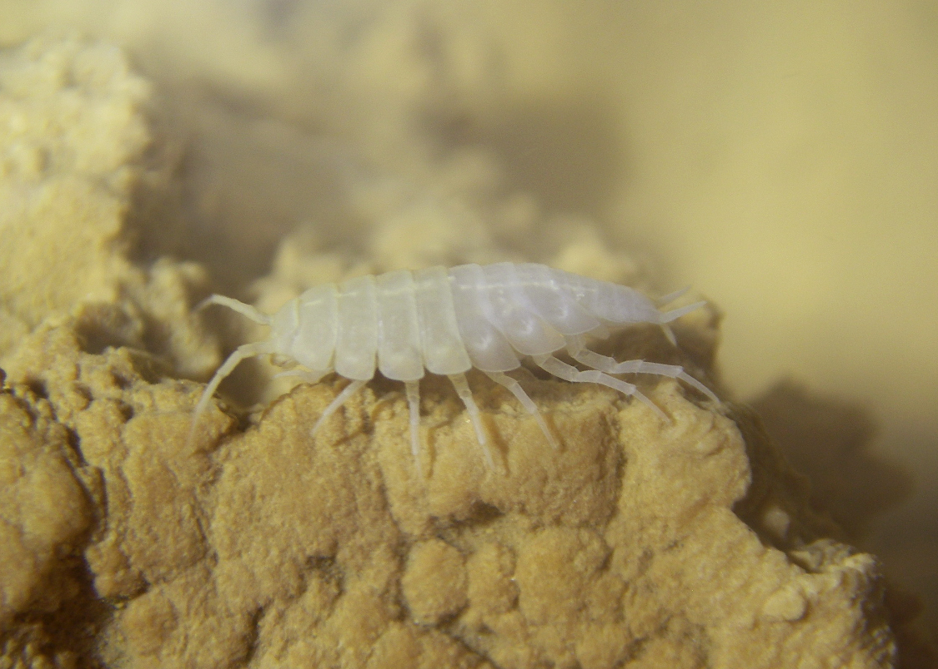
Cantabroniscus primitivus (Aquatic Hoglouse) - Cueva de Riaño.
Image – Tom L Thomson

Slide 27
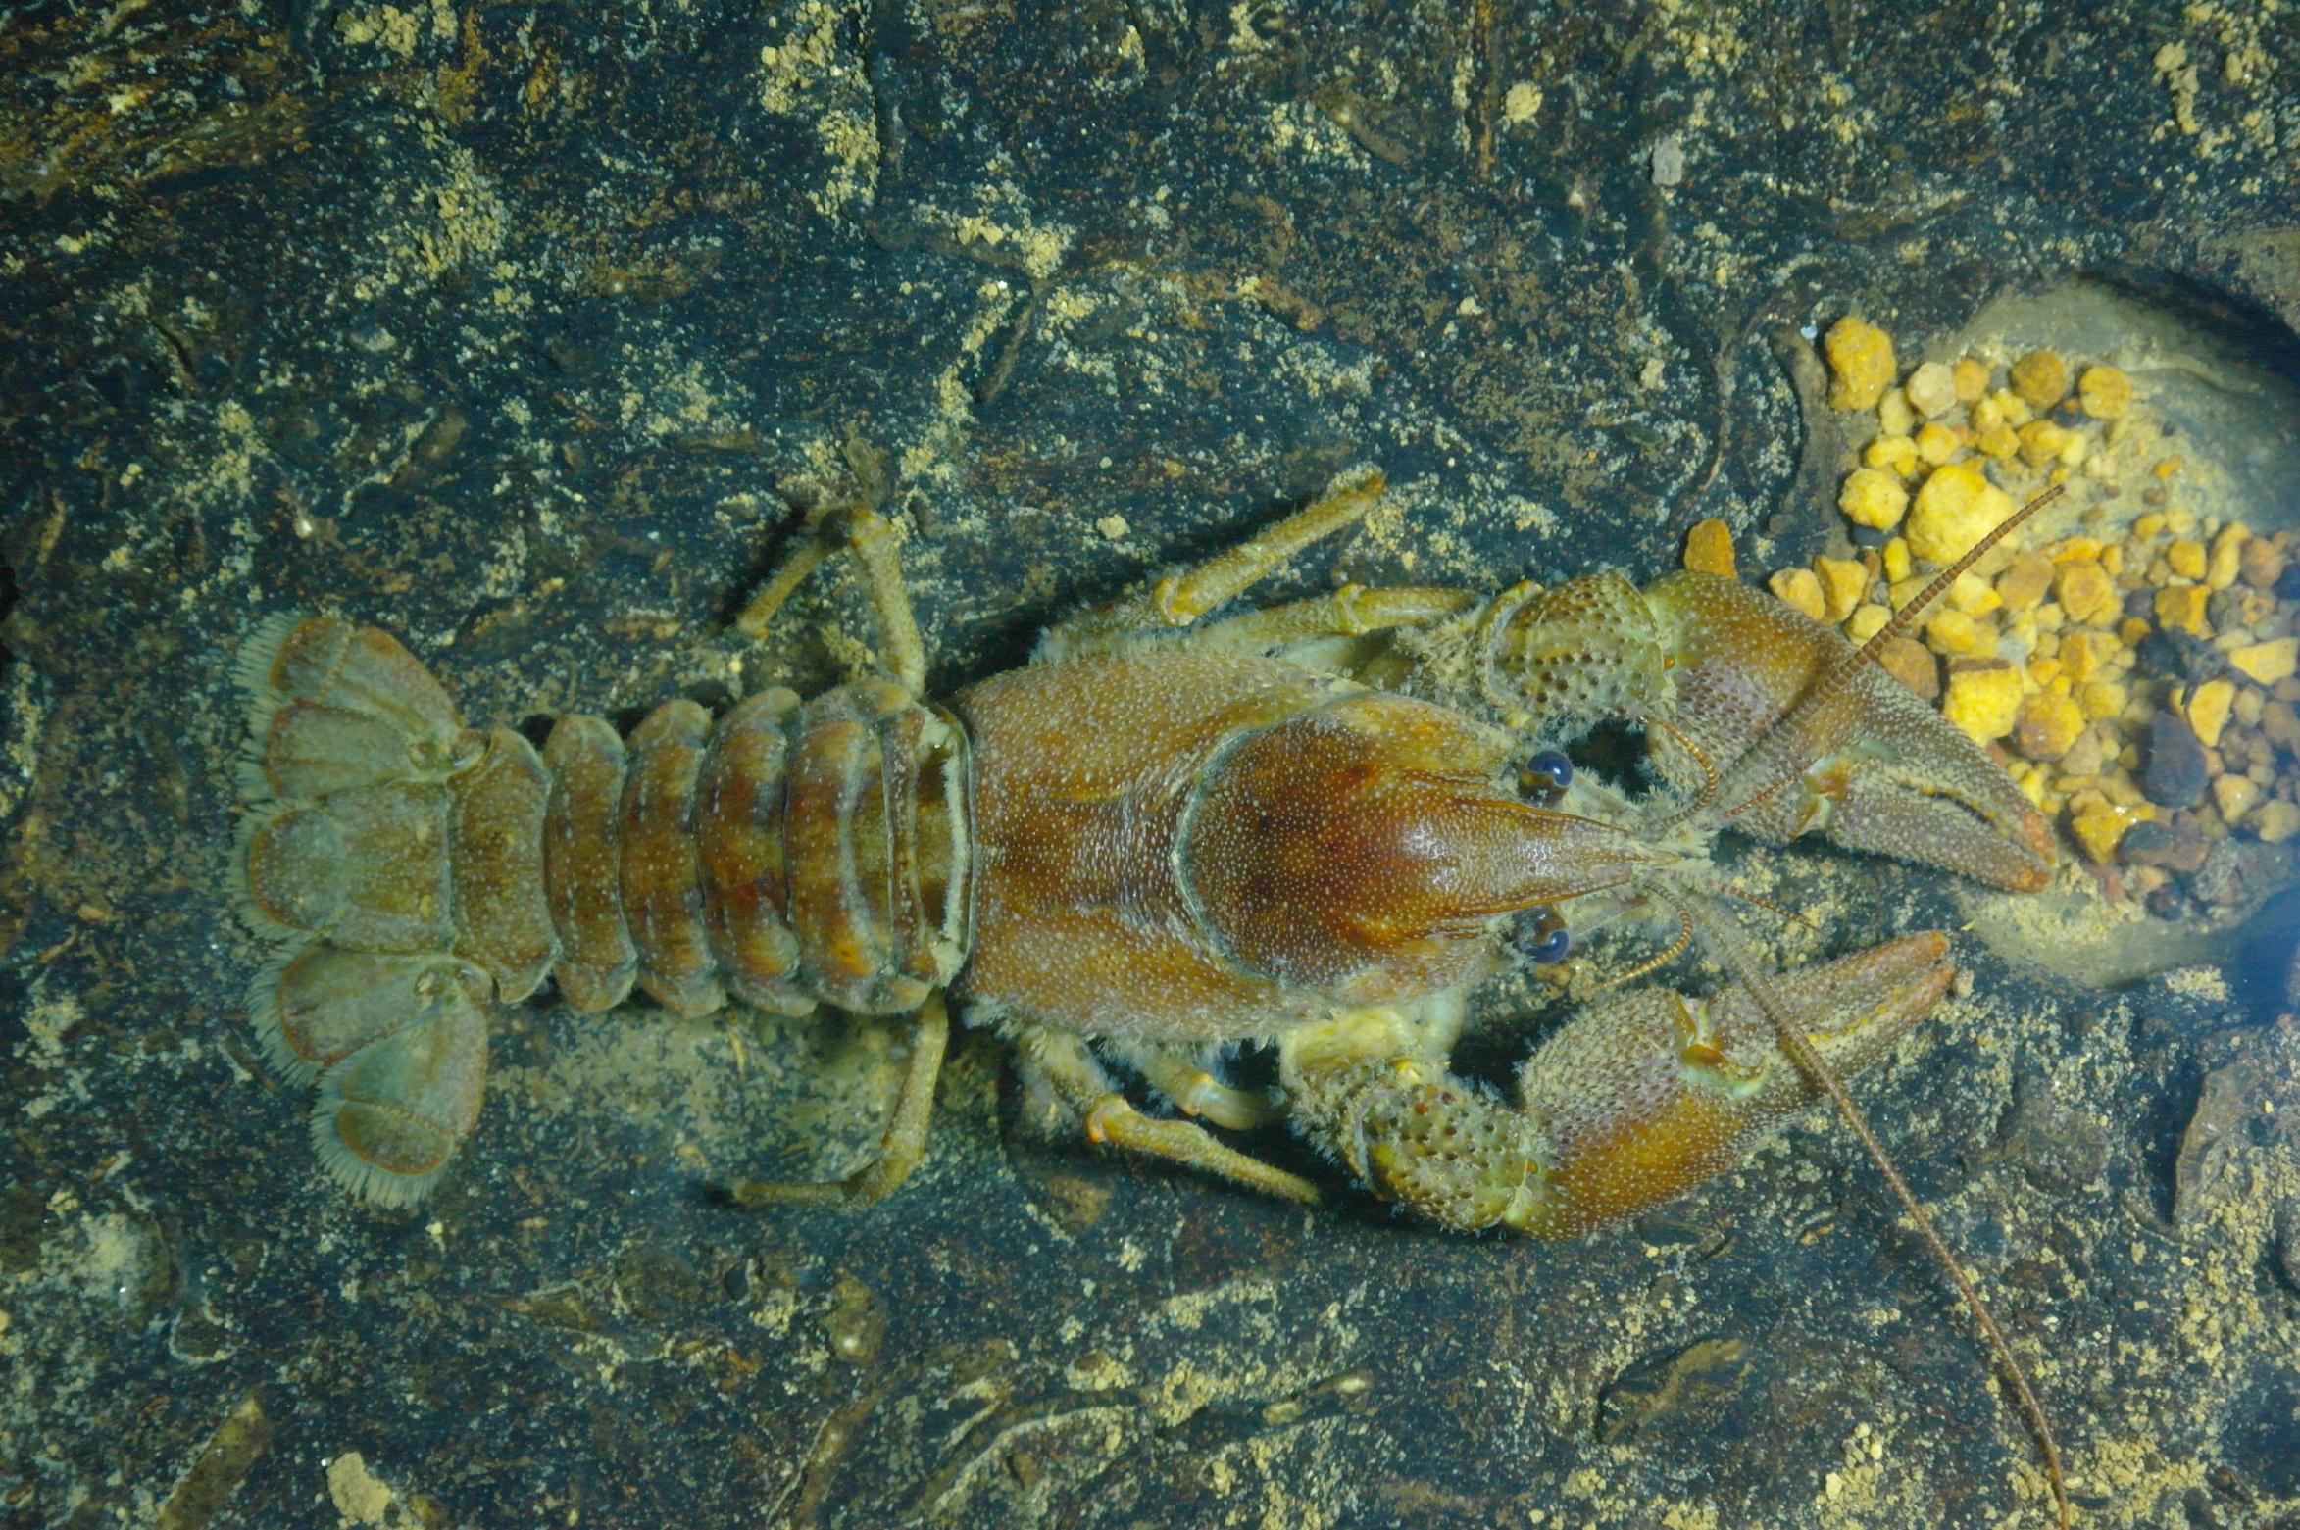
Austropotamobius pallipes (freshwater crayfish) - Cueva de Jivero 2.
Image – Tom L Thomson

Slide 28
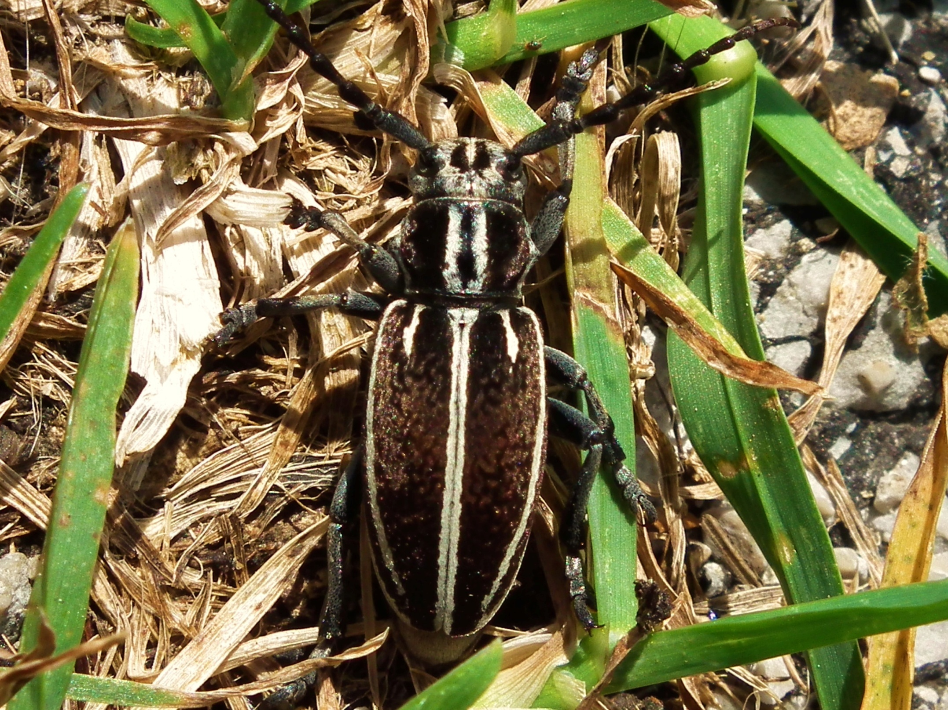
Iberodorcadion molitor (Longhorn beetle ) - Matienzo Valley
Image – Fergus McBurney

Slide 29
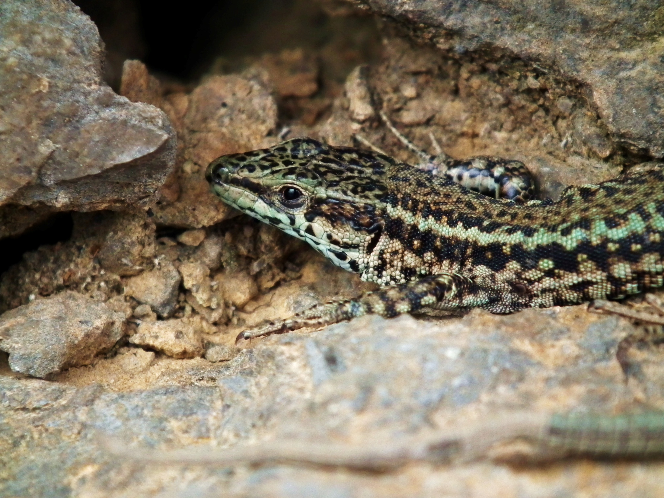
Podarsis hispanica – Iberian wall lizard
Image – Fergus McBurney

Slide 30
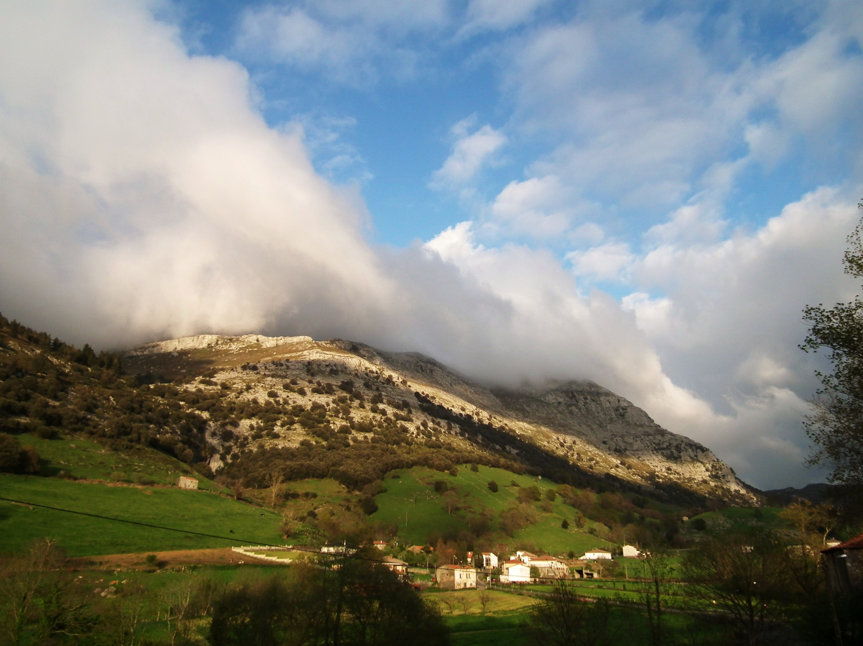
Image – Fergus McBurney

Slide 31
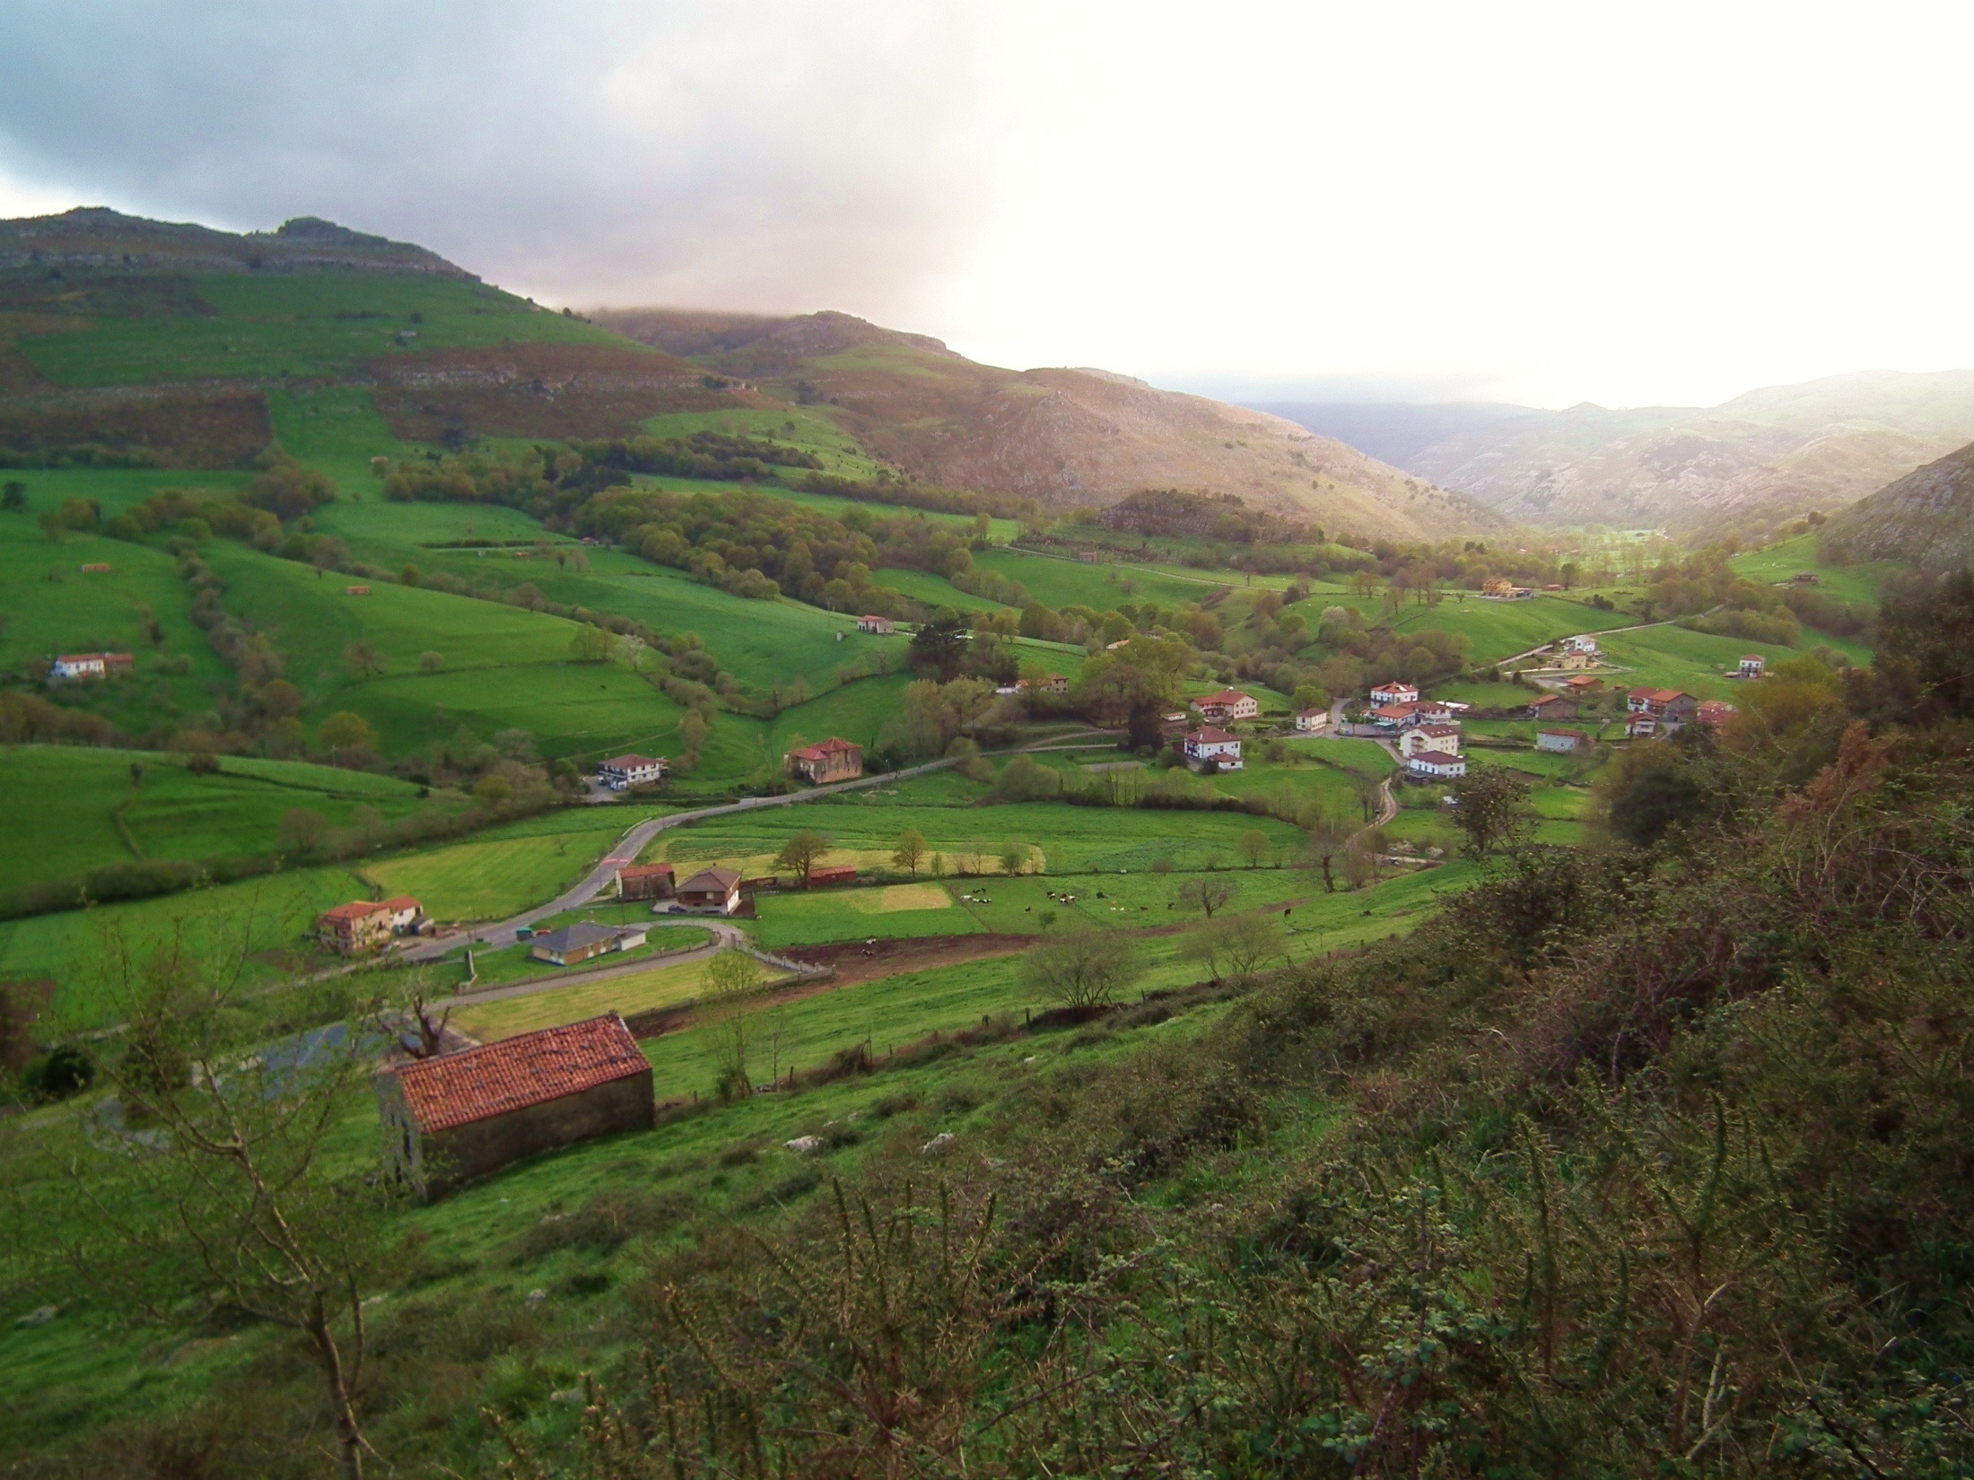
Image – Fergus McBurney

Slide 32
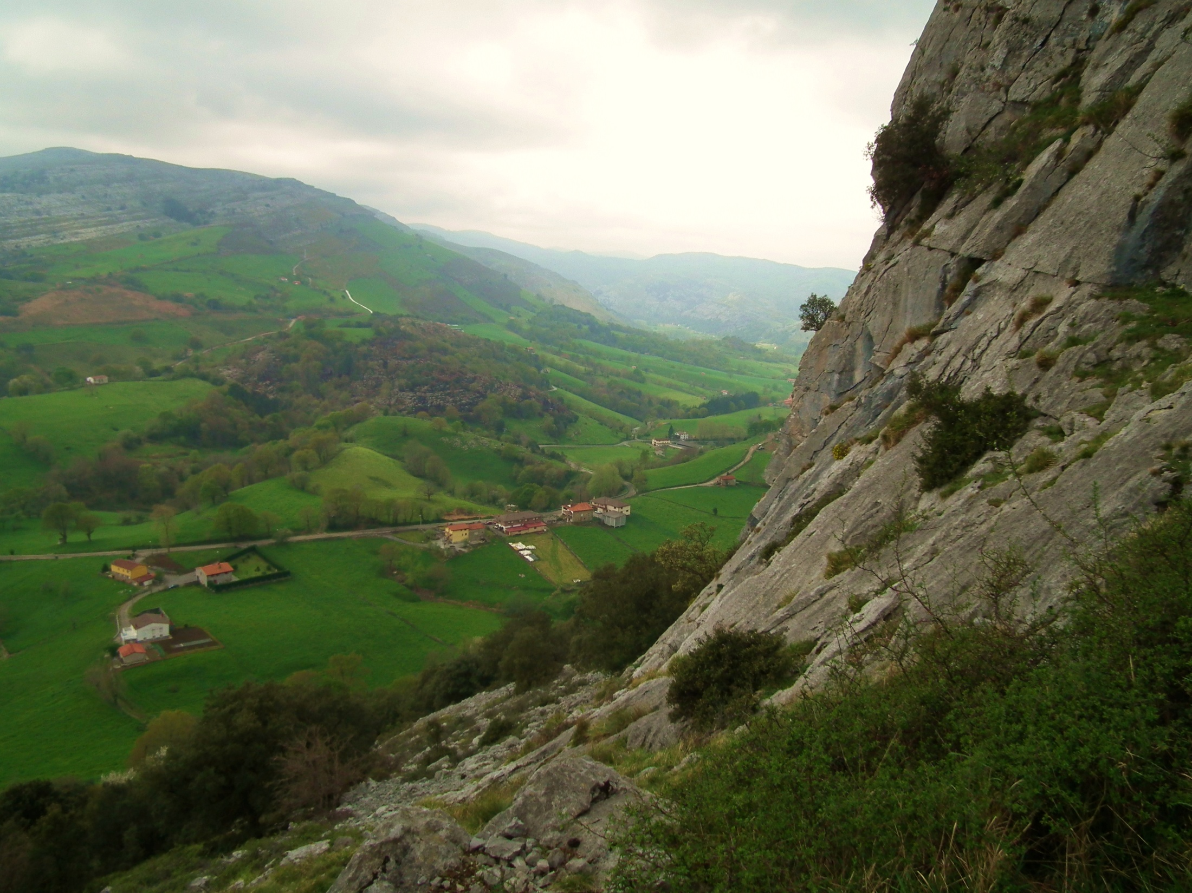
Image – Fergus McBurney

Slide 33
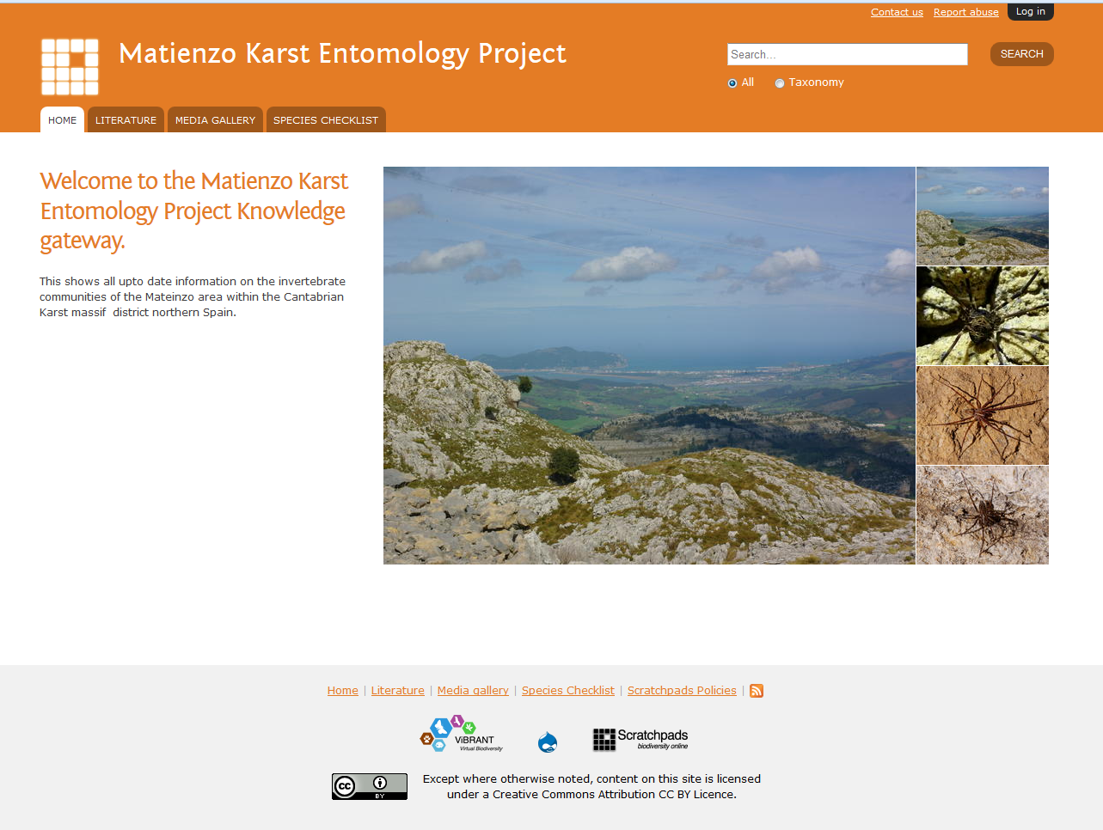

Slide 34
The Matienzo Karst Entomology Project is an Independent initiative supported by:
Results and publications updated at:
www.matienzo-entomology.myspecies.info

